Slide 1
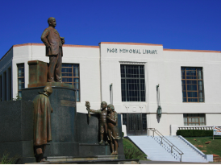
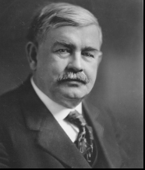
Standards-based Lessons for Middle School:
Sand Springs History Informational Text
Lesson 1 - Charles Page - Slides 4 - 16
Lesson 2 - Captain Breeding - Slides 17 - 20
Lesson 3 - Early Sand Springs Industry - Slides 21-23
Lesson 4 - The Children’s Home and Widow’s Colony - Slides 24-27
Lesson 5 - How Sand Springs Responded To The Tulsa Race Massacre of 1921 - Slides 28-32
Copyright, 2021 Sand Springs Cultural and Historical Museum. For educational and non-commercial use only.

Slide 2
Informational Text Unit - Middle School
The Sand Spring Cultural and Historical Museum
Copyright 2021, For educational and non-commercial use only.

Slide 3
How does the museum use informational text and what can students gain from reading it?
The museum has informational text that helps us look into the past and discover facts and ideas about early Sand Springs history and people. Some of this information can be found on storyboards in glass display cases at the museum. Informational text is also presented with supporting artifacts and photos. The ability to closely read informational text will help students better understand the history of Sand Springs. Understanding the genre patterns and details will help students comprehend the subject matter presented. The ability to make inferences and cite supporting evidence will also improve students abilities to speak or write about what they have learned.

Slide 4
Lesson 1: Charles Page
Exploring Informational Text - Slides 2 -11
Task 1: Close Reading and Citing Evidence - Slide 12 -13
Task 2: Determining meaning from words and phrases - Slide 14
Project Choice Board - Slide 16
Charles Page, The Founder of Sand Springs

Slide 5
OKH.5 The student will
examine Oklahoma’s
political, social, cultural, and
economic transformation
during the early decades
following statehood.
Subject:
Charles Page
Oilman, Entrepreneur, and Philanthropist
Sand Springs history is Oklahoma history.
OKH.5.4 Examine how the economic cycles of boom and bust of the oil industry affected major sectors of employment, mining, and the subsequent development of communities, as well as the role of entrepreneurs,including J.J. McAlester, Frank Phillips, E.W. Marland and Robert S. Kerr, and the designation of Tulsa as the “Oil Capital of the World”.

Slide 6
Objectives:
Identify types of informational text used on museum storyboards and placards.
Demonstrate the ability to cite evidence from the text.
Infer meaning from the text
Define words and phrases from the text.
Analyze Interactions (between individuals, ideas, and events in a text)
Distinguish between facts, reasoned judgments based on evidence
Summarize central ideas from a text
ELA 8.2.R.2 Students will analyze details in literary and nonfiction/informational texts to evaluate patterns of genres.

Slide 7
Descriptive
This kind of text tells you about features or has examples to help you understand.
Problem & Solution
A problem is presented and a solution is given.
Sequence
The text will give steps to do a task or give the order of events as they happen
Compare & Contrast
The text talks about how things are alike and/or how they are different.
Cause and Effect
The text explains what happened and why something happened.
Cue Words -
Such as, specifically, also, in addition to,
For
example
Cue Words -
As a result, because, since, so, cause, issue
Cue Words -
First, next, then, second, third, finally, after, dates
Cue Words -
Same, alike, similar to, different,
Instead, as opposed to, unlike
Cue Words -
Since, because, if, then, therefore, consequently
Notes:
Teacher Notes: Discuss the types of text that a student might see in informational text at the museum. Suggestions for delivery of instruction: Read the slides as a group or assign as an individual assignment. Ask students to evaluate and state whether the text on each slide is mostly descriptive, discusses a problem & solution, explains a sequence, compares & contrasts, or suggests cause & effect. Students should explain their answers.

Slide 8
Oilman, Entrepreneur, and Philanthropist
Charles Page was born in 1860 to a farm family in Arnott, Wisconsin. He was one of eight children. His father died when he was eleven, creating tremendous hardship for the family. The resume of jobs he held to help support his family after his father's death is amazing. The list includes cook, general store clerk, railroad call boy, brakeman, fireman, special agent, and Pinkerton detective.
He married his first wife Lucile (Lucy) in 1881. She had one son whom Page adopted. In 1900 he moved his family to Colorado Springs, where he engaged in real estate development, power plants, and oil well drilling operations. Even after Mr. Page had his own family to support he continued to send money to his mother.
Charles Page moved his family to Oklahoma City in 1901, then to Tulsa in 1903 during Oklahoma's golden age of oil and opportunity. After drilling many dry wells, his efforts paid off and Mr. Page became a wealthy man. In 1908, Native Americans were allowed to sell allotment land to non-tribal members. He purchased 160 acres of land and other properties next to it. This land would become the location of The Children's Home and the beginning of the town of Sand Springs.
What kind of informational text is this? Choose the best answer.
Descriptive c. Sequence
Compare and contrast d. Cause and effect
Notes:
Answer: C

Slide 9
An Investment of Caring
Unlike many of his fellow successful oilman in Tulsa at the turn of the last century, Mr. Page did not invest in art or fine architecture, or a lavish home. Instead, he chose to invest in people. He helped many early Tulsans who found themselves struggling during economic hard times at the beginning of the last century. His friend, Captain Brinton Breeding (who was a captain in the Salvation Army before he went to work with Mr. Page) partnered with him to help wherever they could.
Charles Page was a patron of the Cross and Anchor Orphanage in Tulsa and learned that it was bankrupt. So in 1909, Page paid off the orphanage debt and assumed guardianship for the remaining 21 children. He began construction of a dormitory on the property purchased in Sand Springs, and the children lived in canvas tents during the building process. A matron, cook, and seamstress were hired to care for the children. This original dormitory was completed in 1910 and occupied by approximately 60 children. They were either orphans or their parents were unable to care for them. None of the children were ever to be adopted because Page wanted all siblings to remain together. Mr. Page was genuinely concerned about the children in his care and was thoughtful about the plans he made for them.
What kind of informational text is this? Choose the best answer and support it.
Descriptive c. Sequence e. Problem and solution
Compare and contrast d. Cause and effect
Notes:
Teacher note: The case for all of the above could be made. Students just need to support their answer.

Slide 10
Growing His Investment
In 1912, Page's fortune grew even bigger. Oil was struck at his Elan Orcutt No. 1 well enabling him to respond when his Children’s Home began to grow.
Page began plans for a second dormitory. This structure was designed by Architect Daniel Eichenfeld. Construction on the 30,000 square foot building began in 1916 and was completed in 1918. Mr. Page wanted the children at the home to have experiences like other kids and to have a nice place to live. Consequently, the new dormitory featured a marble staircase, multiple fireplaces, wrap-around porches, and a playground. A large living room and dining room were on the first floor. The second floor held a library, study hall, small meeting room, and the boys' wing. The third floor housed the girls, while the fourth floor was reserved for all children under the age of six.
What kind of informational text is this? (There is more than one answer. Defend your answer.)
Descriptive c. Sequence e. Problem and Solution
Compare and contrast d. Cause and effect
Notes:
Answer: A,D, or E. Student should defend their answer.

Slide 11
A Purposeful Business
Children soon numbered in the hundreds at the Home. Page continued his lavish care of them with annual vacations to exciting destinations, such as the 1915 World's Fair in San Francisco; music lessons; their own sports teams; and paid college tuition. Page was determined that "his kids" should have every opportunity other children had. He spared no expense for teachers, equipment, and other novelties and luxuries.
In addition to investing in children, Mr. Page also established a Widow’s Colony of cottages to provide economically struggling women with children a safe place to live.
But Mr. Page was not just charitably-minded. He also knew that to provide continual support for the Children's Home and the Widow’s Colony he would need to have successful businesses that brought in the necessary income to sustain both of these charities. He believed that by providing free and inexpensive land to businesses he could attract people to the area which would also support the businesses that he started: The Interurban, The Sand Springs Dairy, a water bottling plant, and other business interests, too. Businesses brought jobs to Sand Springs. Job opportunities attracted people. People needed services like grocery stores, pharmacies, and more. The need for services brought more businesses and more jobs. Sand Springs became a thriving area of industry and business.
What kind of informational text is this? (Choose the best answer.)
Descriptive c. Sequence e. Problem and Solution
Compare and contrast d. Cause and effect
Notes:
Answer: A

Slide 12
The Living Legacy of Mr. Page
Mr. Page offered inexpensive utilities, a transportation system, and a water supply to residents and businesses in Sand Springs. He also offered a resettlement bonus to established industries to lure them to the area. Sand Springs soon had a steel mill, a cotton mill, a washing machine factory, a light fixture factory, and many other businesses. Soon the area became known as The Industrial Center of the Southwest.
Mr. Page’s wealth, vision, and generosity created the town of Sand Springs. The primary source of his wealth was oil. As one of the many businessmen of the early twentieth century, he was part of the development of the Tulsa area into what became known as “The Oil Capital of the World.” Oil businesses fueled the economy of Tulsa for many decades.
Other Tulsa oilmen made significant philanthropic contributions to the Tulsa area through their support of the arts and many gave generously to civic and charitable causes. But the story of Charles Page is unique. His investment in both the people and the town he founded lives on. His Children’s Home and the Widow’s Colony (now called The Family Village) are still supported by Charles Page’s business interests.
What kind of informational text is this? (Choose the best answer.)
Descriptive c. Sequence e. Problem and Solution
Compare and contrast d. Cause and effect
Notes:
Answer: A or B. Students should defend their answer.

Slide 13
Task #1: Cite Task 1: Read Closely and Cite Textual Evidence
As you answer the following questions, remember that the information presented about Charles Page is written to educate museum visitors about a respected town founder.
1. The reader can infer that the people of Sand Springs hold Charles Page in high regard. Quote at least two sentences from the text that support this inference.
2. What do you think the author was implying about the difference in Charles Page’s use of his wealth as compared to other early Oklahoma oilmen? (Slide 9) Quote the text to support your answer.
3. The author gave several references to specific years in which events took place. Why is the date of the Orcutt oil well strike important? Describe what happened after the Orcutt 1? (Slide 10 )

Slide 14
Task 1: Read Closely and Cite Textual Evidence, continued...
4. The text used the word lavish twice. Once to contrast Mr. Page’s home with more opulent homes of the day (an adjective): “Mr. Page did not invest in art or fine architecture or a lavish home.” (Slide 9) Once to describe the care of the children: “Page continued his lavish care of them with annual vacations to exciting destinations…” (Slide 11) Do you think the author had a purpose in using the word lavish in both places? Explain your answer.
5. How did Mr. Page create or help others create jobs in Sand Springs? (Slide 11) Cite three specific ways this was accomplished.
6. What kinds of positive things does the author infer about other oilmen contemporaries of Mr. Page? After reading this document, can you infer how other businessmen might have made a similar difference in their communities through their businesses? (Slide 12)
7. How do the captions on the slides show the author’s purpose in writing about Charles Page? List the captions on a piece of paper and write two or three sentences that cite evidence to support the captions.

Slide 15
Task 2: Determine Meanings of Words & Phrases in a Text
Find the bolded words in the slides and match them to the definitions below:
The position of being legally responsible for the care of someone who is unable to manage their own affairs. ________________
Held in trust for the use of individual Indians (or their heirs). __________________
The cash or other benefit offered to bring people or businesses to a different place. ______________________
(adjective) Something that is sumptuously rich, elaborate, or luxurious. _________________
Works for a private security guard and detective agency established in the United States by Scotsman Allan Pinkerton in 1850. ___________________
(verb) Bestow something in generous or extravagant quantities on. ___________________
(adjective) state of a person or organization declared in law unable to pay outstanding debts. _________________________
A railway or train operating or traveling between cities. ________________________
A railroad worker responsible for a train's brakes and other aspects of its operation. ________________________
A large international exhibition designed to showcase achievements of nations. These exhibitions vary in character and are held in different parts of the world at a specific site for a period of time, ranging usually from three to six months. ___________________________

Slide 16
Charles Page Project Choice Board
Visit the Museum Take a picture of 3 items that you find and write some informational text about each one. | Review “Hometown Treasure” Virtual Museum Trunk Show - Complete the 3-2-1 activity at the end of the slide presentation. (Slide 18) | Interview a Docent at the Museum Ask them these questions: Why do you volunteer at the museum? Why is the story of Charles Page important to you? What is the most important thing you tell people about Sand Springs? Write a short paper to share your findings.
Create a song or rap about Charles Page Life – Video and share with the class | Create a Timeline of Charles Page’s Life Add significant dates and places. Write a brief synopsis of the timeline. | Answer this question: 2026 marks the 100th anniversary of Charles Page’s death. What should Sand Springs do to commemorate this? Create a Google Slide or Powerpoint Presentation to show how you think it should be remembered.
Jamboard Brain Dump https://jamboard.google.com/d/1Jbb2saJUyIa91ZYK_Bg-tkdd3qtRjrkwjcf60g2zHuk/edit?usp=sharing | Visit the Museum Use this link to create a Fake Instagram Page with Pictures and copy about the museum and/or Charles Page | Listen to an Interview with Opal Bennefield Clark. Opal was a child who lived at the Children’s Home. Write a 3-2-1 short paper on what you learned (See Slide 18 on the Virtual Trunk Show option above for instructions.)

Slide 17
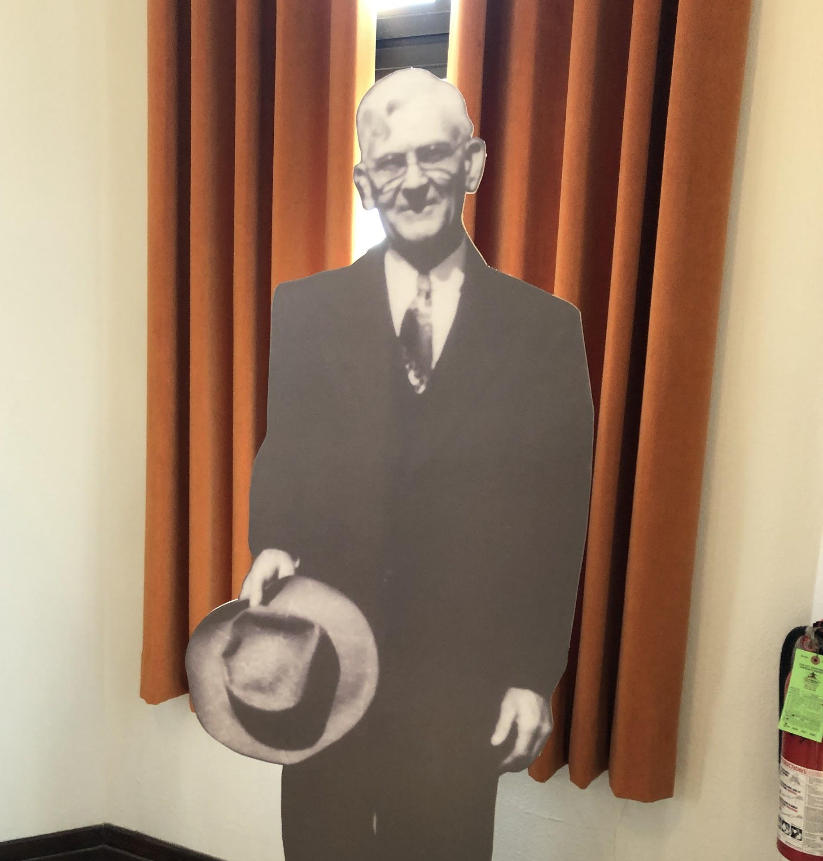
Lesson 2: B. F. Breeding
Exploring Informational Text - Slides 17 - 19
Task 3: - Slide 20
Captain Breeding, A Partner in Doing Good

Slide 18
Partners in Good Work
B. F. Breeding was born in southeastern Kentucky to Dr. Samuel and Annie Hale Breeding. His mother passed away when he was only six years old. His father remarried and the family moved to Yukon, Oklahoma in 1891. Mr. Breeding joined the Salvation Army in 1895, after attending college in Kansas. He met his wife Ethel Smith in Kansas and married her in 1901.
Charles Page met Salvation Army Capt. Breeding during the financial depression of 1907. Breeding had called on Page for a donation toward the rental of a Salvation Army headquarters. At that time, the headquarters was located in the storage basement of Hunts Clothiers on the SW corner of 2nd and Main Streets in Tulsa. Tulsa had no organized charities except for the Salvation Army. Mr. Breeding helped people who were sick, hungry, or just needed a temporary place to stay. Page often provided money that Breeding used to see that people’s needs were met. Page felt that Breeding's background was just what was needed for the Children's Home. He offered him the opportunity of serving others--without pay, but all his needs and those of his family would be provided for. Also, the position was "for life."
Breeding resigned his commission with the Salvation Army in 1908 to work for Charles Page. He, his wife Ethel, and their children (Eva, 5 and Harold, 3) traveled seven miles of undeveloped trails and forded the Arkansas River. Their transportation was a rickety one-horse buggy pulled by an old pensioned horse named Bill. At one point the buggy was falling apart. Breeding used a piece of wire to lash a green oak stick to make the final few miles. The family arrived with a tent and a week's supply of groceries.

Slide 19
Whatever It Took To Get The Job Done
"Cap," as Mr. Page called Mr. Breeding, was instrumental in many aspects of creating and running the Children’s Home. To keep the Home going in the early days Breeding bottled water from the springs and sold it for 25 cents per five-gallon container. He had many different responsibilities and carried out Mr. Page’s directions. In the early days as The Children’s Home was being built, he made many trips along a muddy seven-mile dirt trek from Tulsa to Sand Spring carrying wagon loads of supplies. Sometimes he meted out disciple for wayward Home kids. Whatever was needed, Mr. Breeding was Mr. Page’s right-hand man.
Mr. Breeding wrote monthly letters for several decades to the children still in the home and the men and women that had grown up in the Home. He wrote news about the Home and the people that worked and lived there. He shared some of his poetry. He wrote about scriptural wisdom that related to their lives and making good decisions.
Breeding retired in 1948 after working at the Home for 41 years. However, he continued to stay in touch with the "Home Kids" after many of them grew up.
B. F. Breeding died on March 31, 1974, at 98 years of age. The meeting and subsequent partnership and friendship between Page and Breeding changed their lives and those of many others.
What kind of informational text is this? Choose the best answer.
Descriptive c. Sequence e. Problem and solution
Compare and contrast d. Cause and effect
Notes:
Answer: A or C

Slide 20
Task 3: Analyze Interactions (between individuals, ideas, and events in a text)
Answer the following questions in complete sentences. Make sure your answers use details from the text.
What did Mr. Page and Captain Breeding have in common?
How was their partnership divided into different roles?
What does the description of Captain and Mrs. Breeding’s journey out to the land where Sand Springs is today suggest about the Breeding’s personal financial situation when they took the job with Mr. Page?
What does the description of the journey tell you about the area that is now Sand Springs in the early days?
The Sand Springs Children’s Home was home to 30 children in 1910. Mr. Breeding was active in his leadership of the Home until 1948 but stayed involved in other ways until his death in 1974. The text tells about things he did after he retired. How would you describe Captain Breeding’s commitment to Mr. Page and The Children’s Home? Cite evidence from the text to support your answer.
Notes:
Some possible answers:
The desire to help people.
Mr. Page was the initiator of activities and events. Captain Breeding carried out or supervised others to carry out the work.
The family did not have a lot of material resources. They were in a rickety wagon.
It was rough and raw land. It was not easy to travel over.
Captain Breeding was committed to helping Mr. Page. He stayed involved over many years (41 years) to help Mr. Page and to work with the children of the home. Even after he retired, he continued to do what he could to help.

Slide 21
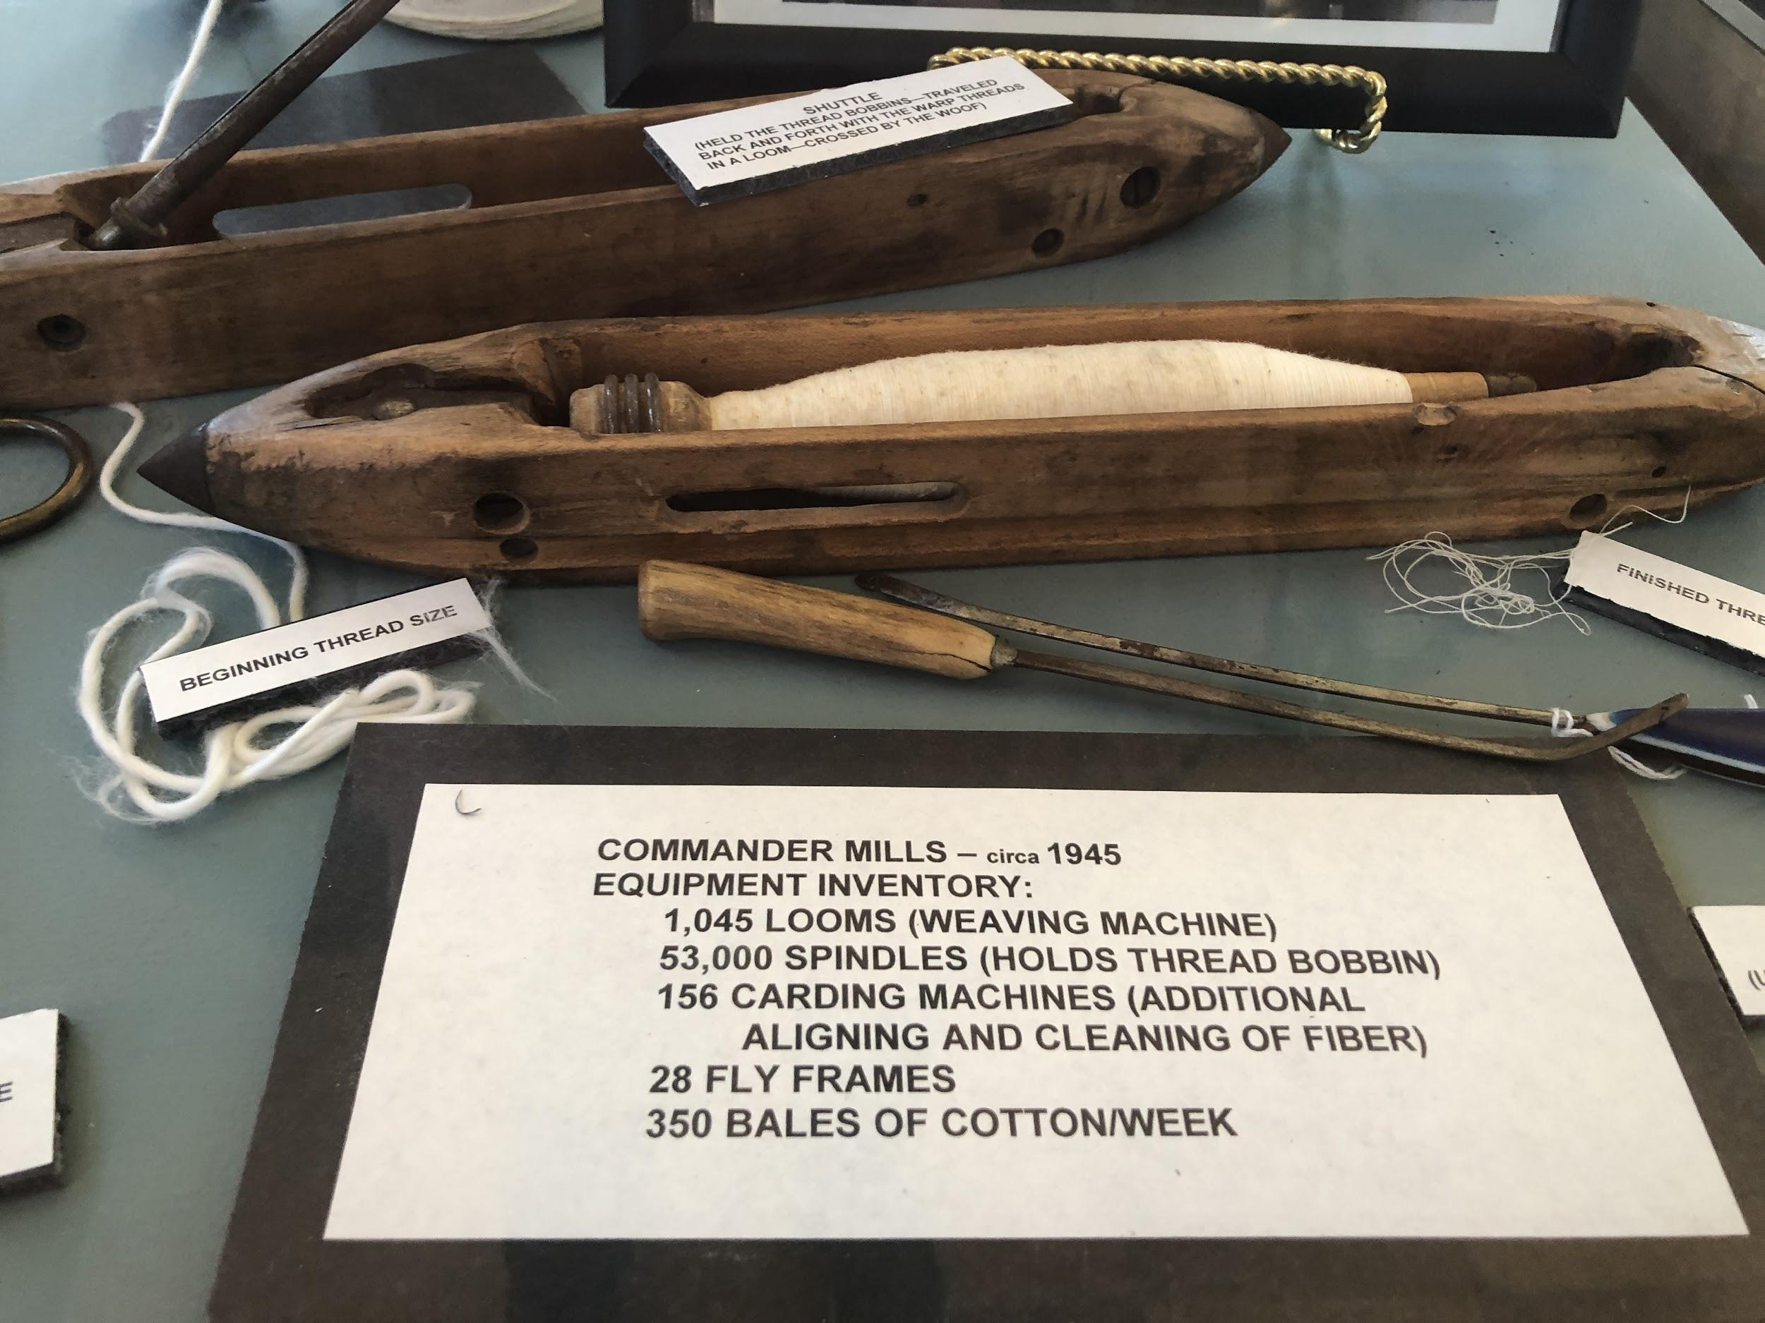
Lesson 3: The Industrial Center of the Southwest
Exploring Informational Text - Slide 22
Task 4: - Slide 23

Slide 22
Early Sand Springs Industry
During the early days of Sand Springs, Page devoted his interests to developing and attracting industry to the area. He thought of everything needed in order to sustain the Children's Home and to make Sand Springs a place that would support people with jobs. .
Mr. Page’s businesses included: Sand Springs Home Creamery; Sand Springs Hospital; Shell Creek Reservoir (power and water); Sand Springs Greenhouse; Sand Springs Railway; Farms; and the Power Plant. He also worked on developing storm and sanitary sewer systems.
Mr. Page provided many incentives to entice other businesses to settle in Sand Springs. Many were offered free or inexpensive land and a resettlement bonus. His goal was to grow the city and also to provide jobs for the women of the Widow’s Colony and people moving into the area. Among the many enterprises that took Page up on his offer were:
Osage Iron and Steel; Tulsa Rolling Mills; Commander Mills (textile manufacturing); Pierce/Sinclair Coal and Fuel Oil Refinery; Zinc Smelter; Hubbard and Kelly Lamp and Chimney Factory, later known as Kerr Glass Manufacturing; Pedrick Laboratories; Gavril Chenille Company
View the Museum’s Virtual Trunk Early Sand Springs Industry Trunk Show Link Here: https://docs.google.com/presentation/d/1BoceE4l4PLADwhYdDcr3kkio_mOEN4z_ujBH6J_MYR8/edit?usp=sharing

Slide 23
Task 4: Distinguish Among Facts, Reasoned Judgment Based on Research Findings, & Speculation in a Text
When reading historical information, you want to make sure it is credible information, information that you can believe and trust. One thing that makes historical information more credible is when it includes reasoned judgment that is based on research findings from primary and secondary sources. Without facts, information can be biased or not based on anything more than opinion.
Primary sources include documents or artifacts created by a witness to or participant in an event. They can be firsthand testimony or evidence created during the time period that you are studying.
Primary sources may include diaries, letters, interviews, oral histories, photographs, newspaper articles, government documents, poems, novels, plays, and music. The collection and analysis of primary sources is central to historical research.
Secondary sources analyze a scholarly question and often use primary sources as evidence.
Secondary sources include books and articles about a topic. They may include lists of sources, i.e. bibliographies, that may lead you to other primary or secondary sources.
Databases help you identify articles in scholarly journals or books on a particular topic.
Source: https://guides.lib.uw.edu/c.php?g=344285&p=2580599
Directions: Review the previous slide (Slide 25) and the Virtual Trunk Show. Since many of these early Sand Springs businesses are not longer in operation how do you that they existed during the time periods suggested in the text? Review the source information. List three sources. Discuss why you believe each source is a primary or secondary source.
Notes:
Possible sources:
https://www.okhistory.org/publications/enc/entry.php?entry=GL002
https://www.okhistory.org/publications/enc/entry.php?entry=SA017
https://www.history.com/topics/us-states/oklahoma
https://www.okhistory.org/publications/enc/entry.php?entry=GL002
https://www.okhistory.org/publications/enc/entry.php?entryname=MANUFACTURING
Sources:
https://tulsaworld.com/archive/sand-springs-timepiece/article_a0785244-f415-538c-a15f-58daa92cd990.html
https://www.okhistory.org/publications/enc/entry.php?entry=SA017
https://www.sandspringsok.org/482/Historic-Tour-3-Waiting-Station
https://sandspringsok.org/DocumentCenter/View/3050/2017-PAFR?bidId=
https://tulsaworld.com/archive/sand-springs-timepiece/article_a0785244-f415-538c-a15f-58daa92cd990.htm

Slide 24
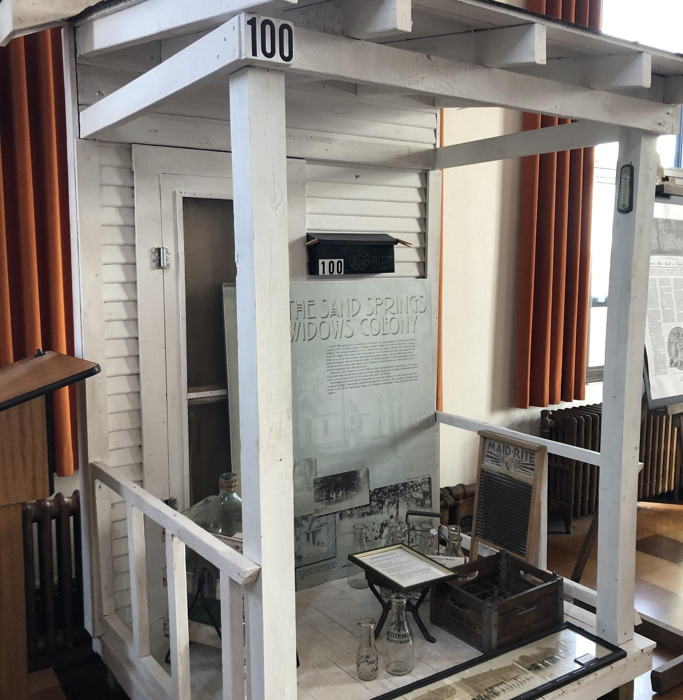
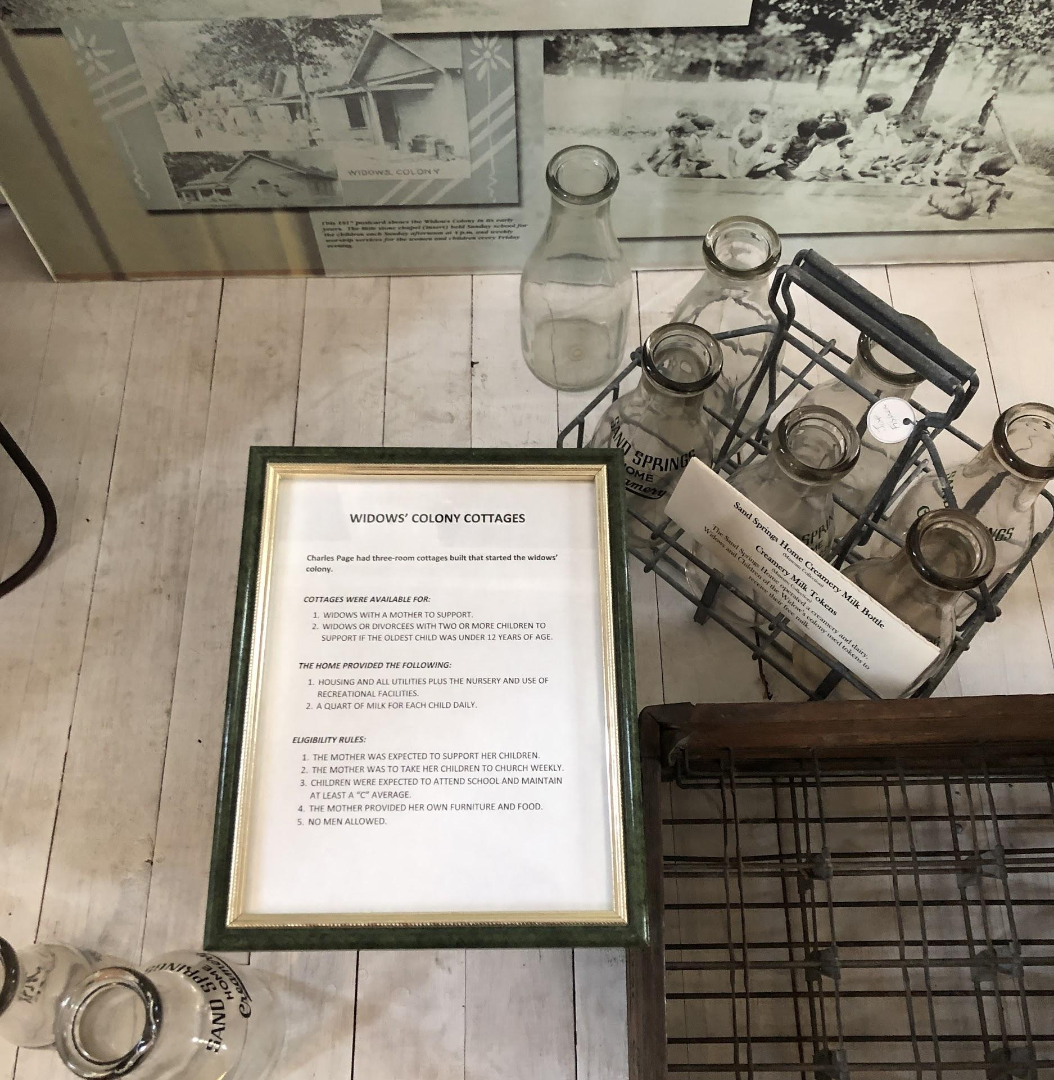
Lesson 4: The Children’s Home and Widow’s Colony
Exploring Informational Text - Slide 25
Task 5: - Slide 27

Slide 25
The Children’s Home Yesterday and Today
From its humble beginning on wildland and a makeshift tent to family-style cottage homes today, the Children’s Home still serves children. In 1912, Charles Page incorporated the Home and appointed a Board of Trustees. The Home has never received financial aid or government support. It is completely self-sustaining and continues today to help children in need. The Board members act as stewards of the foundation Page started and guardians for his legacy of caring.
Three Trustees are selected from the Brotherhood of the Free and Accepted Masons by the Grand Master of that organization per Charles Pages’s instructions. Mr. Page respected the men of the Masonic organization at the time as honest men who understood his vision. Although Mr. Page donated land for churches and respected many of the ministers of his day, he did not want the Children’s Home to be associated with a particular church denomination and chose the Masonic Lodge instead.
The Home's source of funding comes from worldwide investments which were originally supported by the local enterprises Page brought to Sand Springs. Among them are/were the Sand Springs Railway; Commander Mills textile manufacturing; Pierce/Sinclair Oil Refinery; U. S. Zinc Company; Sheffield Steel; Pedrick Laboratories; Glass Manufacturing; Water and Power Company; Sand Springs State Bank; Kerr, Hubbard and Kelly Lamp and Chimney Factory; Vigo Dog Food; and Phoenix Refinery. Most of these no longer exist. The Home's assets include land, oil, and gas.

Slide 26
Widow’s Colony To Family Village
The Children's Home was not the end of Page's dream--only the beginning. He felt widows with children should not live with the orphans, so in 1916, he built a group of 30 small cottages--the Widow's Colony--for widowed and divorced mothers with two or more children. Grandmothers were permitted to live with their daughters and her children, as well.
The cottages consisted of two or three rooms with a porch. The women paid no rent or utilities but were encouraged to find work. Page provided a day nursery, medical assistance, milk, and basic food items. The Home paid the grocery bills of widows who were unable to find work or those with children too young to leave at the nursery, This assistance provided the help needed for the mothers to better their lives and the lives of their children. The first widow in this Colony later served as one of the Home Matrons.
The Family Village, once called the Widows' Colony, still supports mothers and their children and provides homes in the community.

Slide 27
Task 5: Review Text Constructs
Thinking back to the five types of text discussed in Lesson 1, determine which of the 5 types of text best fits the informational text on Slides 24 and 25 and cite evidence to support your answer.

Slide 28
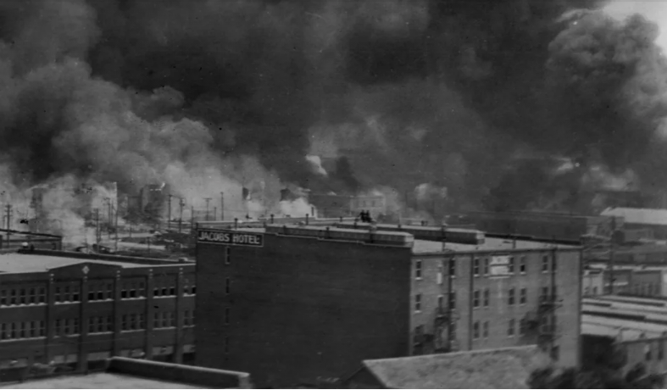
Lesson 5: The Tulsa Race Massacre
Exploring Informational Text - Slide 28
Task 6: - Slide 31

Slide 29
Transcribed from the Sand Springs Leader edition dated Friday, June 10th, 1921 - numerous print or transcription errors are noted with (sic)
To read this, you will need to understand what (sic) means. Sic used in brackets after a copied or quoted word that appears odd or erroneous to show that the word is quoted exactly as it stands in the original text.
Relief work among the negroes [sic] who suffered in the riot fire in Tulsa on last Tuesday night and Wednesday morning and who were sent to Sand Springs to receive aid, was launched at a meeting at the municipal building on Friday afternoon.
The gathering was called together by Mayor Heinz who declared relief work urgently was needed and asked the citizens assembled to help in the formation of an organization to handle the mater [sic]. Following the appointment of E. M. Monselle as treasurer, a number of committees were named to look after the various phases of proper collection and distribution of food and clothing for the refugees sent here.
Garments and wearables of all kinds will be collected at the Sand Springs railway building, where there will be some one [sic] to receive them. Anyone in Sand Springs having a car will be glad to call at any home having bundles to be taken to the railway build [sic]
The Sand Springs woman’s club above that which is needed for refugees who are now in Sand Springs will be delivered by the local relief Tulsa for similar use there.
See next slide

Slide 30
With the co-operation of the Sand Springs school board, it was concluded that cooking and preparation and serving of means would be conqueted [sic] in the domestic science department of the colored school building, which is well equipped with stoves, dishes and utensils of kitchen use. It was learned from representatives from among the negroes [sic] that a hall in the colored section could be used for sleeping purposes if necessity demanded; but with all of the refugees now here are being quarted [sic]in the homes of other negroes, and emphasis was laid on provender and clothing more than on other phases of relief.
“Tell ‘em to start the flour mill to running,” said Charles Page, who entered the meeting at this junction. “I’ll feed all of them that are here. They can get ice and beef and such things from Sand Springs Home, and we’ve plenty of lumber to up sleeping and living quarters if necessary.
The meeting was called at 1 o’clock and an hour later automobiles flitting here and there gathering clothing and provisions.
Sand Springs luckily escaped any trouble caused by the violence in Tulsa. On Wednesday morning shortly after 8 o’clock, an automobile load of armed young men appeared on the streets of Sand Springs looking for [sentence unfinished].
During Tuesday night and again on Wednesday, a special police patrol of six members remained on guard duty to quell any disturbance that stopped by Chief Wabble before they entered the black zone and [unreadable] back toward Tulsa.
[missing sentence] might arise. Negroes (sic) of Sand Springs were kept close within their quarters all day Wednesday and the special police prohibited any and all whites from entering the district inhabited by negroes [sic].

Slide 31
Task 7: Summarize Central Ideas
In the text, the newspaper article tells of the events surrounding Sand Springs role in the Tulsa Race Massacre response.
What does the tone of the article suggest to you about the feelings of the people who gathered to help?
How does the response of Charles Page in this story support the idea that he was willing to help people in need?
How does the article support or not support the idea that Sand Springs people were willing to give aid and assistance to the people who were displaced from the Greenwood District? Write 3 ways the people of Sand Springs helped or could have helped more and cite evidence from the text to support your answer.
Bonus question 1:
How does the article suggest the reality of white and black segregation under Jim Crow laws:
...shortly after statehood in 1907, the Oklahoma State legislature passed a series of statutes that would come to be known as Jim Crow laws, essentially enforcing racial segregation and, in some cases, inciting racial violence.
Source: Oklahoma: Home to More Historically All-Black Towns than Any Other US State - Oklahoma Center for the Humanities
Cite evidence from the text in your response.
Bonus question 2: Why do you think the transcriptionist use (sic) after the word “negroes?” Give a short explanation of why you think this is important to note in reading source information.

Slide 32
Other Race Massacre Resources:
https://www.tulsa2021.org/resources
https://static1.squarespace.com/static/5ea8334f5334b8122b5ac3e6/t/600b492f024f6955813f97e6/1611352379898/TRMCC+-+1-DAY+LESSON+PLAN+%28UPDATED%29
https://static1.squarespace.com/static/5ea8334f5334b8122b5ac3e6/t/600b49500649ad38a1ac7c46/1611352420483/TRMCC+-+5-DAY+LESSON+PLAN+%28UPDATED%29
https://www.teacherspayteachers.com/Browse/Search:tulsa%20race%20massacre

