Slide 1
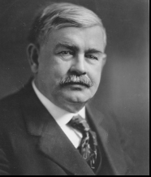
The Story of Charles Page
for PreK - 3rd Grade
Note: The slides can be used to tell the story over 1 day or 5 days. Included with each day’s story are discussion questions as well as optional grade-specific, standards-aligned lesson slides. Day 5 can be a retelling of the whole story and assessment activities. There is a separate optional Activity Guide for PreK/K with Resource Materials and a Picture File.
Questions or Comments? Please call us @ 918-246-2509 or email us @ ssmuseumss2@gmail.com
Read or tell the story and use the suggested activities to help students understand the unique story of Sand Springs and its role in Oklahoma history.

Slide 2
Teacher Information
Contributors:
Sherry Morris, B.S. Early Childhood Education
Susan Edwards, B. S. Elementary Education
Leland Leslie, M. S. Secondary Education
Mary Eubanks, Museum Board Member
Stephanie Moore, Museum Board Member
Staff Oversight:
Ginger Murphy, Museum Director
Dianna Phillips, Museum Coordinator
These materials have been prepared by the Sand Springs Museum Association Board’s Education Committee in collaboration with the staff and the Sand Springs Museum Trust.
We want these to work in your classroom and welcome your suggestions and comments
A standards-based activities guide is also available for grades PreK-K.
The Day 1 Story Lesson Slides are aligned with ELA standards for PreK-Grade 3.
The Day 2 - 4 Story Lesson Slides align with Oklahoma Social Studies Academic Standards for Pre-K through Grade 3.
Day 5 is intended to be a review of the whole story and assessment.

Slide 3
Sources:
Clark, Opal Bennefield. A Fool’s Enterprise: The Life of Charles Page, Dexter Publishing Company, 1989.
Landis, Jamye K. Images of America: Sand Springs, Oklahoma. Arcadia Publishing, South Carolina. Copyright, 1999.
https://www.okhistory.org/publications/enc/entry.php?entry=PA003
https://www.tulsahistory.org/halloffame/charles-page/
https://timesmachine.nytimes.com/timesmachine/1915/09/12/104233776.pdf
https://tulsaworld.com/archive/only-in-oklahoma-sand-springs-founder-helped-others/article_05542add-751a-52ef-b2cc-65f39f32de6b.html
http://www.voicesofoklahoma.com/wp-content/uploads/2016/06/Page-Transcript.pdf
https://sandspringsok.org/483/Historic-Tour-4-Sand-Springs-Home
Sand Springs Cultural and Historical Museum Archives
Connie Fisher, Hometown Storyteller and museum docent
Ruth Ellen Henry, Hometown Storyteller and museum docent
Alleene Bishop, Hometown Storyteller and museum docent
Special Thanks to the Sand Springs Museum Staff and the Museum Association Board Education Committee for their encouragement and assistance with this project.

Slide 4
Background Information
Subject: Early Entrepreneur and Philanthropist: Charles Page – The Founder of Sand Springs
Background Information for Teachers:
The decades following statehood were a time of great opportunity for some and great hardship for others. One man found a way to turn his economic opportunities into a philanthropic creative venture that is a unique part of the Oklahoma story. His name was Charles Page. There are a variety of resources available to inspire Sand Springs students to learn about their hometown history not the least of which is the Sand Springs Cultural and Historical Museum, located at 9 E. Broadway in Sand Springs. The art deco building, originally designed as a public library, was dedicated in 1929 and created as a tribute to Mr. Page by his wife, Lucile. It now serves the community as a resource for art and historical exhibits as well as an affectionate repository of Charles Page’s legacy.
OKH.5 The student will examine Oklahoma’s political, social, cultural, and economic transformation during the early decades following statehood.

Slide 5
Background Information, cont.
While Charles Page was economically gaining ground at the turn of the century, others were struggling. There were many cycles of economic downturns that affected the lives of subsistence farmers, a common occupation at the time. Workers in oil fields were killed or maimed as a result of no safeguards in place to protect workers. Also
at the turn of the 20th century, there were few charities or societal constructs in place to help people in need. Women, whose opportunities were very limited, and their children suffered great hardships when men died or left their families. Because Charles Page had lost his father at a young age and watched his mother struggle to care for the family, it was to these people that he offered help and hope.
Mr. Page was not just civic-minded. He understood that for his charity work to be maintained he would need substantial income. He viewed business and industry as the means by which money flowing into a town would sustain jobs and therefore families and would produce a stable community.
The following lessons have been created to encourage young students to learn about a part of a unique community history that affects our town’s economic and cultural development today. These lessons for younger children are intended to help students personalize and connect with social studies standards.
E.2 The student will evaluate how societies answer the three basic economic questions: what goods and services to produce, how to produce them and for whom are they produced.

Slide 6
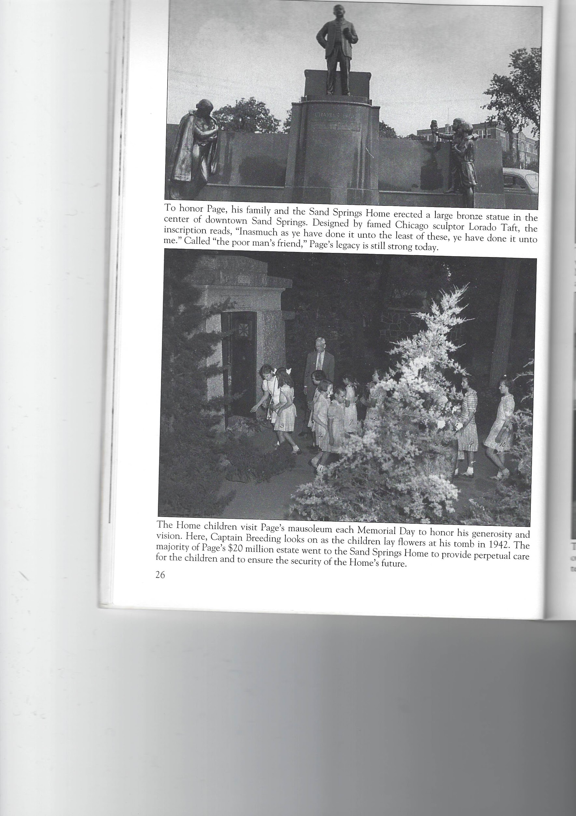
Notes:
Ask students if they have seen this in Sand Springs and do they know who it is and why he was important enough to be honored with a statue.

Slide 7
The Story of Charles Page
Provided By:
The Sand Springs Cultural and Historical Museum
Copyright 2021, Sand Springs Cultural and Historical Museum, for educational and non-commercial use only. Permission required for any other use.

Slide 8
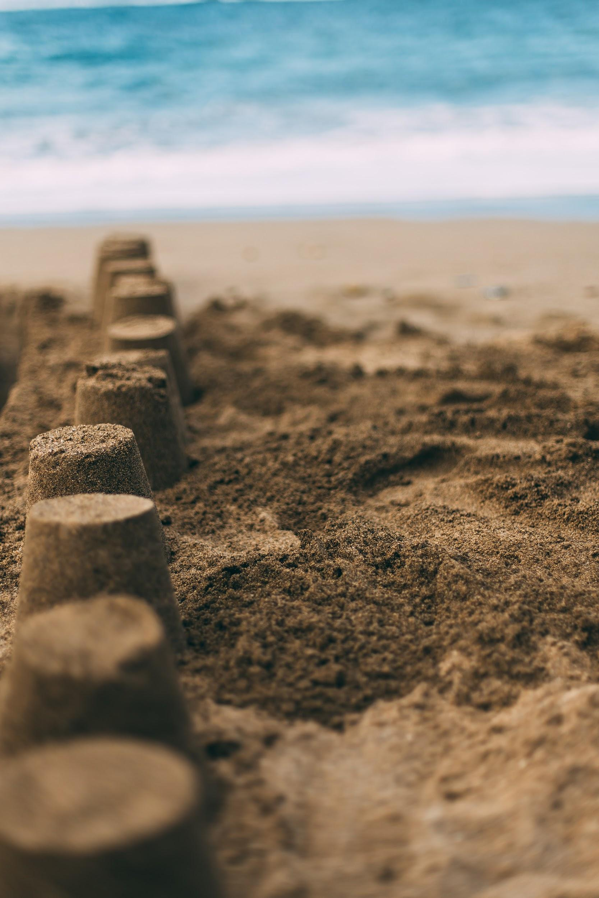
The solution
The Beginning of a Dream – Day 1 Story
“Charlie!” called his mother. “Come in now. It’s suppertime.” Charlie was startled by the sound of his mother’s voice. He was having so much fun making buildings and roads in the sand. He had forgotten that he wasn’t really in his imaginary city. “Okay, mom,” he replied. “I’ll be in soon.” He took a last look at the city he had built and went inside for supper.
Charlie was just 5 years old. He showed his father the sand and mud city and probably told him all about the things he built. “Here is the hotel. Here is the bank. Over here is the church and the school,” he could have explained proudly. His father thought his son had a wonderful imagination and was very creative. But some older boys came and knocked over the buildings that Charlie had built. It made Charlie sad and angry, but he just said, “Someday I will build a city that you can’t knock down.”
At age 5, Charlie Page made a city of mud and dirt.
Notes:
Source: Clark, Opal Bennefield. A Fool’s Enterprise: The Life of Charles Page, Dexter Publishing Company, 1989. Pg. 12.
Photo Courtesy of unsplash.com (Free images)

Slide 9
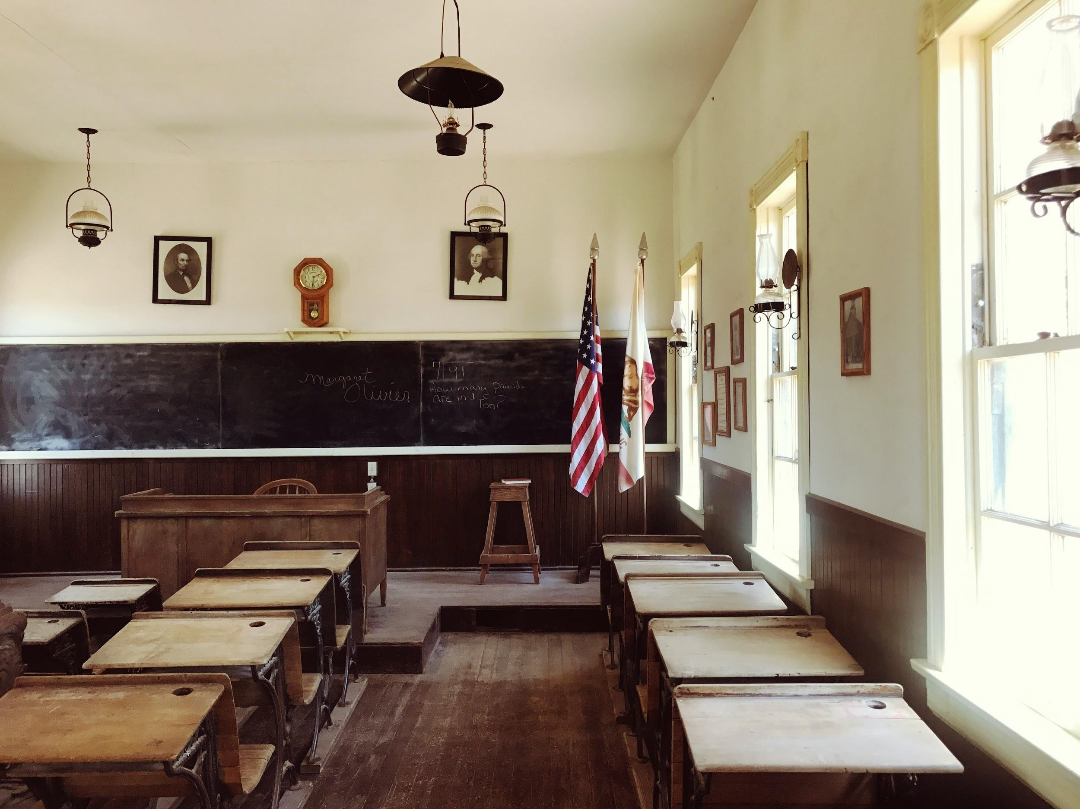
Charlie grew to be a clever and creative boy. He had all kinds of ideas on ways to do things that others just didn’t think about doing. His ideas were often very good and he found imaginative ways to get things done.
But when Charlie was eleven years old his father died. It made Charlie sad and changed a lot of things for his family. One day he found his mother crying because she was so worried about how she could earn money. He said, “Don’t worry, mother. When I get to be a man you won’t have to work. I’ll take care of you.”
In those days of long ago some boys, even as young as 11, had to quit school to work so they could help their families earn enough money to eat and to have a home. Charlie’s mother didn’t like it, but she knew that she had no choice. Charlie quit school and worked many jobs to help take care of his family. He worked in a store, hauled timber, was a police officer,* a miner, and more! Whatever he could find to do he did so he could help his family.
Charlie stopped going to school and went to work to help his family.
Notes:
Source: Clark, Opal Bennefield. A Fool’s Enterprise: The Life of Charles Page, Dexter Publishing Company, 1989. Pg. 13, 14, 17.
Photo courtesy of unsplash.com (Free images)
*Mr. Page worked for the Pinkerton Detective Agency.. For more about this historic agency that is still in operation today, see this link.

Slide 10
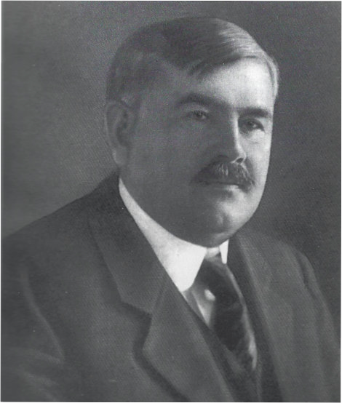
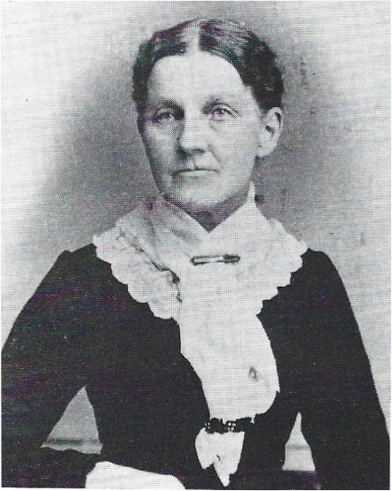
Everyone noticed that there was something special about Charlie. He had become a kind and thoughtful young man. He was big and could stand up for himself, but he also was always willing to help others if he could.
Charlie grew up and was now called Charles Page. He married a woman named Lucy. Even though he was very clever and worked very hard, he didn’t always make enough money. He tried different ways to make money for his family. No matter what, he always sent money home to his mother because he had promised to take care of her.
Charles Page’s Mother:
Mary Ann Page
Charles Page continued to help his mother after he was married.
Notes:
Photo credit (Mary Ann Page) and Source:
Clark, Opal Bennefield. A Fool’s Enterprise: The Life of Charles Page, Dexter Publishing Company, 1989. Pg. 15-16; Pg 20 -21. Photo page. 276.
Photo credit: Landis, Jamye K. Images of America: Sand Springs, Oklahoma. Arcadia Publishing, South Carolina. Copyright, 1999.

Slide 11


If he had 10 dimes, he would give 1 dime to help others.
But one day he found himself very short of money. Charles was worried. How could he take care of his own family and send money to his mother, too? As he was thinking about it, he met a lady who asked him to give some money to help the poor. Charles told her he didn’t have much left. The woman told him that everything that people have is a blessing. She said, “If we are blessed with something, we should give part of our blessings to others.” Charles decided she was right and pulled some money from his wallet.
Soon after, Charles found a new way to make a lot of money. He always remembered that very special day. Charles knew that he had learned an important lesson about giving. Mr. Page always gave some of his money (often 10%) to help others. He believed that when he helped others, the good he did would come back to him.
10 dimes - 1 dime = ___ dimes
Charles Page decided that he would always give some of his money to help others.
Notes:
Source: Clark, Opal Bennefield. A Fool’s Enterprise: The Life of Charles Page, Dexter Publishing Company, 1989. Pg. 22.
See Resource Material 1 for Give-Away Cards that demonstrate giving 10%.

Slide 12
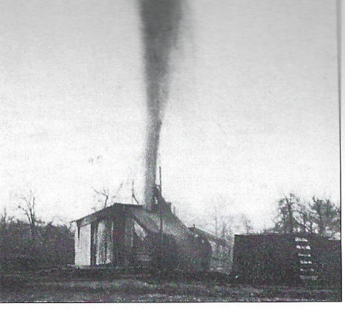
Soon Mr. Page became a very rich man. His company found oil in many places like Glenn’s Pool (the town of Glenpool as it is called today). Oil was very important in those days. Cars were just being built and needed gasoline which was made from oil. People used oil and natural gas to heat their homes. By finding the oil in the ground, Mr. Page was able to sell it and make lots of money.
Remembering the lesson of giving he’d learned years before, Mr. Page thought he could people if he learned that they needed help. He decided the best way to live was to “Think Right.” To him that meant using his blessings to help others. Some people thought Mr. Page was crazy to help people instead of keeping all his money for himself. Mr. Page just ignored them. He just kept using part of his money to help others because he believed he had been blessed and it was the right thing to do.
Here’s what an early oil well looked like.
Notes:
Clark, Opal Bennefield. A Fool’s Enterprise: The Life of Charles Page, Dexter Publishing Company, 1989. Pg. 28; 35; 53,54;
Photo credit: Landis, Jamye K. Images of America: Sand Springs, Oklahoma. Arcadia Publishing, South Carolina. Copyright, 1999.

Slide 13
Day 1 - Discussion Questions
Who built a city in the sand and mud?
How do you think he felt when the older boys knocked his town down?
What did he say he would do about it?
When Charlie’s father died, his mother had a difficult time taking care of his family. What did Charlie say he would do to help?
When Charlie gave money even when he didn’t have very much, what happened?
Why did Charlie always remember this?
Charlie’s motto was to “Think Right.” What did “Think Right” mean to Charlie?
Suggested Activities: See Day 1 in the SSMU Standards-based Activities for PreK/K or use the following grade specific, standards-based Extension Activity Slides.
Photo credit: Landis, Jamye K. Images of America: Sand Springs, Oklahoma. Arcadia Publishing, South Carolina. Copyright, 1999.
Charles Page as a young man
Notes:
Teacher Notes: (Some possible answers to discussion questions)
Who built a city in the sand and mud? (Charlie Page)
How do you think he felt when the older boys knocked his town down? (sad, angry, disappointed, determined)
What did he say he would do about it? (He said he would build a city no one could knock down.)
When Charlie’s father died, his mother had a difficult time taking care of his family. What did Charlie say he would do to help? (He would always send his mother money as soon as he was old enough to work.)
When Charlie gave money even when he didn’t have very much, what happened? (He found a new way to make lots of money.) Why did Charlie always remember this day? (He believed that when people give to help others, good things will happen to them because giving is the right thing to do.)
Charlie’s motto was to “Think Right.” What did “Think Right” mean to Charlie? (To Charlie, Think Right meant that to think right was to act right and to do right. Doing right included he sharing part of what he had to help others.)

Slide 14
PREK/Standard 4: Vocabulary
Students will expand their working vocabularies to effectively communicate and understand texts.
Use these DAY ONE Extension Activity Slides or see the separate suggested Activities Guide, Resources, and Picture File.
Vocabulary Words PK. 4.R.1 Listen to the sentences from the story and see if you can guess the correct word.
Charlie took a last look at the ____ he had built and went inside for supper.
Which word belongs? City, State, or Country
One day Charlie found his mother crying because she was so worried about how she could earn ____.
Which word belongs? Toys, Money, or Food
Charlie always gave some of his money (often 10%) to help ____.
Which word belongs? Dogs, Horses, or People
___ was very important in those days because cars were just being built and needed gasoline which was made from ____.
Which word belongs? Electricity, Water, Oil
NOTE: Use colored popsicle sticks and ask students to hold up the stick that represents the correct answer.
Write these vocabulary words and illustrate them: city, money, oil. Tell your teacher about what you have written or illustrated. PK.4.W.1
Geography and Economics Domain Vocabulary
Reading
Students will expand academic, domain-appropriate,
grade-level vocabularies through reading, word study, and class discussion.
PK. 4.R.1 Students will acquire new academic,
content-specific, grade-level vocabulary and
relate new words to prior knowledge with
guidance and support.
Writing
Students will apply knowledge of vocabularies to
communicate by using descriptive, academic, and
domain-appropriate abstract and concrete words in their writing.
PK.4.W.1 Students will begin to use new vocabulary to
produce and expand complete sentences in
shared language activities.
Notes:
Answers: City, Money, People, Oil

Slide 15
K Standard 1: Speaking and Listening
Students will speak and listen effectively in a variety of situations including, but not limited to, responses to reading and writing.
Listening/Sharing Buddies
Form pairs of two. Ask students to explain one thing they have learned about Charles Page to their partner. Talk about rules for discussion - listen to your partner; ask question if you have one; take your turn, etc. K.1.R.1; K.1.W.2
Provide picture-word cards to use as prompts - See Resource Picture 16. Invite students to share what they learned with the large group. Suggest they use the cards to help them explain what they have learned. K.1.R.3
Large Group Discussion - See Questions provided at the end of day one’s story. K.1.R.3
Draw something you learned about Charles Page and caption it. See Resource Page for a worksheet. Be prepared to share your story. K.1.W.1
*Resource Picture File Link: Scroll down to Picture 16.
Reading
Students will develop and apply effective communication skills through speaking and active listening.
K.1.R.1 Students will actively listen and speak using
agreed-upon rules for discussion with guidance
and support.
K.1.R.3 Students will engage in collaborative
discussions about appropriate topics and texts
with peers and adults in small and large groups
with guidance and support.
Writing
Students will develop and apply effective communication skills through speaking and active listening to create individual and group projects and presentations.
K.1.W.1 Students will orally describe personal interests or tell stories, facing the audience and speaking clearly in complete sentences and following implicit rules for conversation, including taking turns and staying on topic.
K.1.W.2 Students will work respectfully with others with guidance and support.

Slide 16
1st Grade - Standard 1: Speaking and Listening Students will speak and listen effectively in a variety of situations including, but not limited to, responses to reading and writing
Choose one or more of these activities:
Listening/Sharing Buddies
Form pairs of two. Ask students to explain one thing they have learned about Charles Page to their partner. Talk about rules for discussion - listen to your partner; ask question if you have one; take your turn, etc. 1.1.R.1
Provide picture-word cards to use as prompts - See Resource Picture 16. Invite students to share what they learned with the large group. Suggest they use the cards to help them explain what they have learned. 1.1.W.1
Large Group Discussion - See Questions provided at the end of day one story. 1.1.R.1 1.1.W.1
Write about and/or draw something you learned about Charles Page. Be prepared to share your story. 1.1.W.1
*Resource Picture File Link: Scroll down to Picture 18.
Reading Students will develop and apply effective communication skills through speaking and active listening. 1.1.R.1 Students will actively listen and speak using agreed-upon rules for discussion.
Writing 1.1.W.1 Students will orally describe people, places, things, and events with relevant details expressing their ideas.

Slide 17
2nd Grade Standard 1: Speaking and Listening Students will speak and listen effectively in a variety of situations including, but not limited to, responses to reading and writing.
Choose one or more of these activities:
Listening/Sharing Buddies
Form pairs of two. Ask students to explain one thing they have learned about Charles Page to their partner. Talk about rules for discussion - listen to your partner; ask question if you have one; take your turn, etc. 2.1.R.1
Provide picture-word cards to use as prompts - See Resource Picture 16.* Invite students to share what they learned with the large group. Suggest they use the cards to help them explain what they have learned. 2.1.R.1 2.1.R.3
Large Group Discussion - See Questions provided at the end of day one story. 2.1.R.3
Write about and draw something you learned about Charles Page. Be prepared to share your story. 2.1.W.1
*Resource Picture File Link: Scroll down to Picture 16.
Reading
2.1.R.1 Students will actively listen and speak using appropriate discussion rules.
2.1.R.3 Students will engage in collaborative discussions about appropriate topics and texts with peers and adults in small and large groups.
Writing 2.1.W.1 Students will report on a topic or text, tell a story or recount an experience with appropriate facts and relevant, descriptive details, speaking audibly in coherent sentences.

Slide 18
3rd Grade Standard 1: Speaking and Listening Students will speak and listen effectively in a variety of situations including, but not limited to, responses to reading and writing.
Choose one or more of these activities:
Listening/Sharing Buddies
Form pairs of two. Ask students to explain one thing they have learned about Charles Page to their partner. Talk about rules for discussion - listen to your partner; ask question if you have one; take your turn, etc. 3.1.R.3
Provide picture-word cards to use as prompts - See Resource Picture File 16.*. Invite students to share what they learned with the large group. Suggest they use the cards to help them explain what they have learned. 3.1.R.3
Large Group Discussion - See Questions provided at the end of day one story. 3.1.R.3
Write about and draw something you learned about Charles Page. Be prepared to share your story. 3.1.W.1
Reading 3.1.R.3 Students will engage in collaborative discussions about appropriate topics and texts, expressing their own ideas clearly in pairs, diverse groups, and whole class settings.
Writing 3.1.W.1 Students will report on a topic or text, tell a story, or recount an experience with appropriate facts and relevant, descriptive details, speaking audibly in coherent sentences.
Notes:
*Resource Picture File Link: Scroll down to Picture 16.

Slide 19
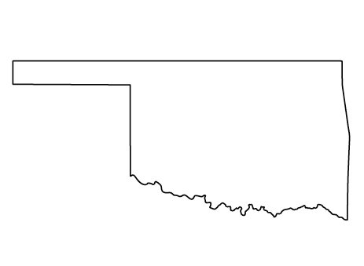
The Beginning of Sand Springs –
Day 2 Story
Before Oklahoma became a state, Sand Springs was just a forest of trees with springs of water. Tulsa was just beginning to become a city. There were no cars. People travelled on horseback or in wagons pulled by horses. Trains carried people around the country and took crops like wheat, corn, and oats to markets to be sold. Tulsa and Sand Springs were very different than they are today.
But around the time Oklahoma became a state, many things were about to change...
What state is this? Where is Sand Springs on this map? Where is Tulsa?
Notes:
K.2.3 Identify the shape of the state of Oklahoma on a map.
Point out approximately where Tulsa and Sand Springs would be on this map. See Day 2 in the Activities Guide for Pre/K and K includes a map for students to mark and label (Resource Material 5.)

Slide 20
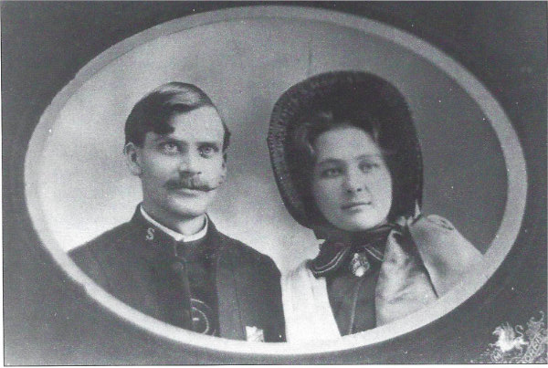
Charles Page lived in Tulsa around the time that Oklahoma became a state. He met a man in Tulsa named Captain Breeding who worked for the Salvation Army. In those days, the Salvation Army was one of the few groups in Tulsa that tried to help people.
Charles Page and Captain Breeding became good friends. Mr. Page knew that Mr. Breeding was a good man who also wanted to help others He often gave Captain Breeding money to help people who were hungry or who needed a place to stay. Things were not easy for many people during Tulsa’s early days. Sometimes food and money were not easy to get.
Captain and Mrs. Breeding
Notes:
Source: Clark, Opal Bennefield. A Fool’s Enterprise: The Life of Charles Page, Dexter Publishing Company, 1989. Pg. 83.
Photo credit: Landis, Jamye K. Images of America: Sand Springs, Oklahoma. Arcadia Publishing, South Carolina. Copyright, 1999.

Slide 21
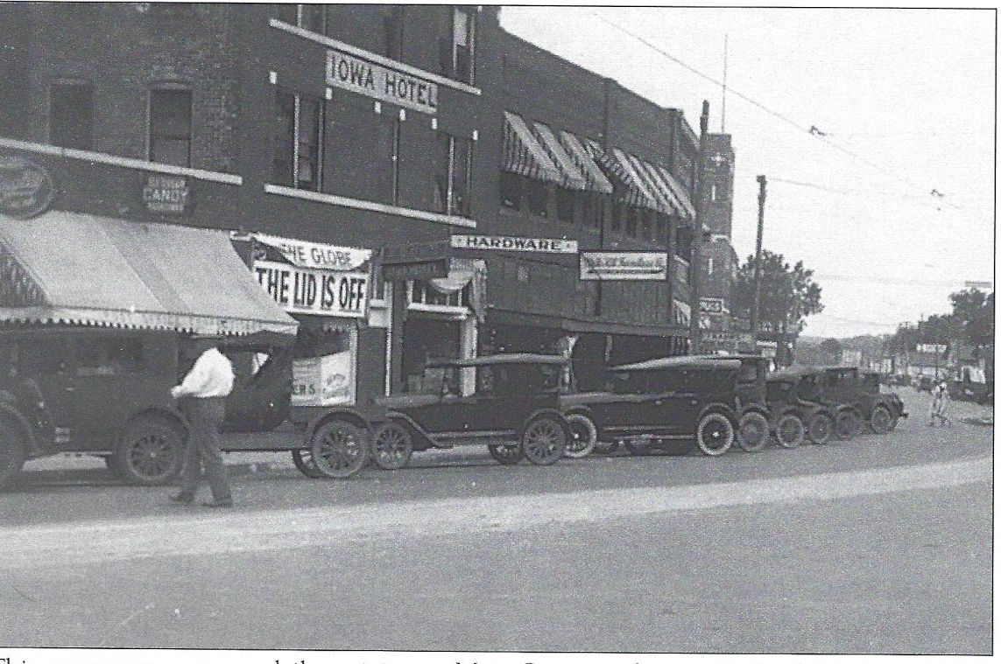
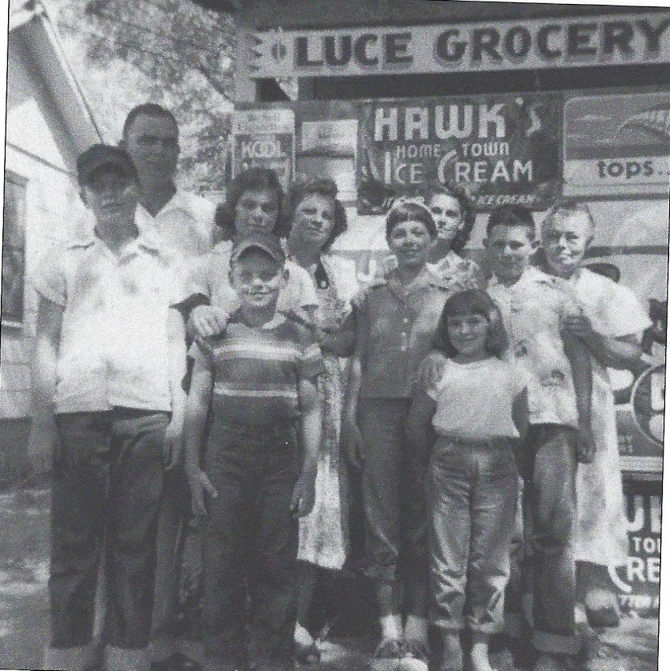
What kinds of businesses would a new town need?
Charles Page told Captain Breeding about his dream to build a town where people could work and support their families. He also thought he could start businesses that would give people jobs. He knew that if he was successful with his businesses that other businesses would come to his town. Businesses provide people what they need to live in a town: food, clothes, homes, and places to eat or have fun, and more. He was looking for land close to Tulsa where all this could happen.
Captain Breeding thought Mr. Page had some good ideas and wanted to help.
Notes:
Teacher Note: Encourage students to think about what kinds of businesses we have today and what kinds of businesses people might have needed then.
Photo credits: Landis, Jamye K. Images of America: Sand Springs, Oklahoma. Arcadia Publishing, South Carolina. Copyright, 1999.

Slide 22
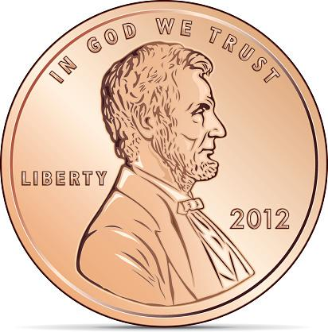
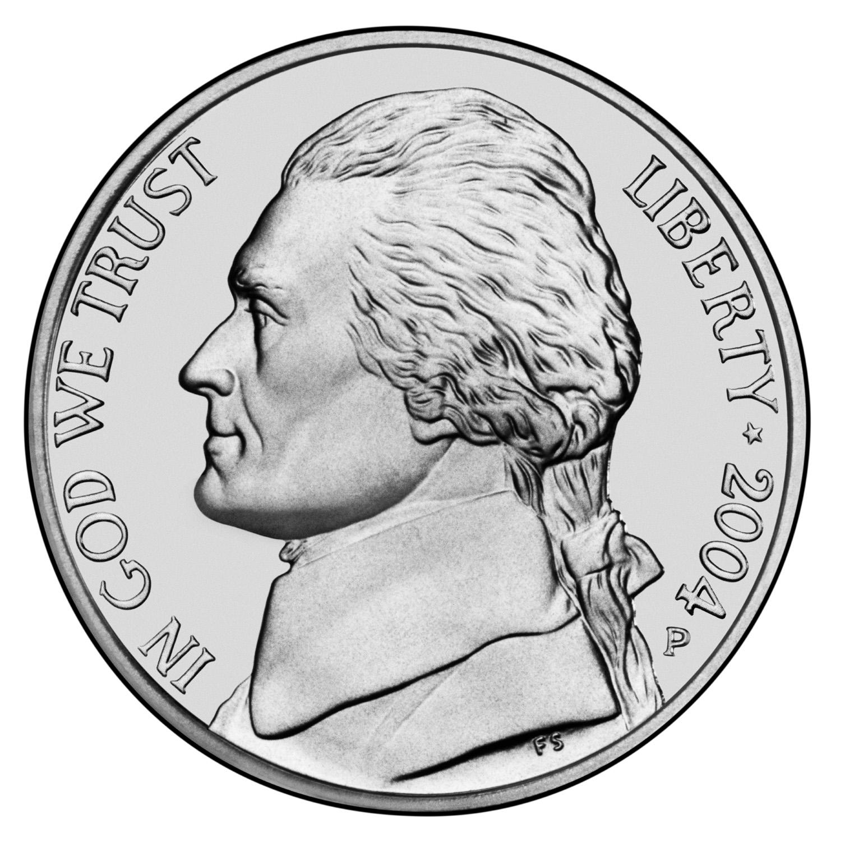
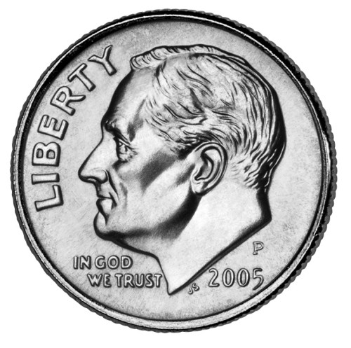
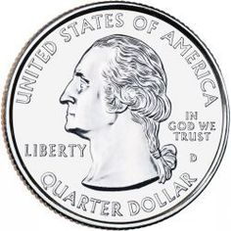
Mr. Page bought some land west of Tulsa (the area now known as Sand Springs) to start building his town.
He asked Mr. Breeding and his wife to come and help. Mr. Page wanted to start a farm on his land.
But one day Mr. Page learned that Tulsa’s Cross and Anchor Children’s Home was closing because not enough people could or would give money to help care for the children.
So Mr. Page decided that he would build a children’s home on some of his land. He also thought the farm would help to provide food for the children’s home.
The Cross and Anchor Home was closing because there was not enough money being given from the Tulsa community to keep it open.
Notes:
Map skill opportunity: Demonstrate cardinal directions on the Oklahoma state map: North, South, East, West. Sand Springs was west of Tulsa on the map. See Slide 16 for a OK map.
Source: Clark, Opal Bennefield. A Fool’s Enterprise: The Life of Charles Page, Dexter Publishing Company, 1989. Pg. 56-57; 82-88

Slide 23
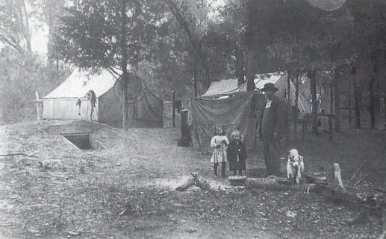
On one very exciting day, a wagon was loaded with the children from the home. They were starting a new adventure. They were going to a place in the woods where their new home would be built.
On the way they stopped to see Mr. Page. It was his birthday, June 2, 1909. He called to them. “How are my kids today?” One little girl asked, “Are we your kids now?” Mr. Page said, “You bet.” From that day on, children at the home called Mr. Page, Daddy Page.¹
1 Clark, Opal Bennefield. A Fool’s Enterprise: The Life of Charles Page. pg. 92
The tents where some children lived while the Sand Springs Home was being built. This is believed to be an early photo for a postcard.
Notes:
Students can discover many sources which cite how the Sand Springs Home children called Mr. Page, “Daddy Page.” In addition to Opal Clark’s book, note these sources: https://sandspringsok.org/483/Historic-Tour-4-Sand-Springs-Home;
http://www.voicesofoklahoma.com/wp-content/uploads/2016/06/Page-Transcript.pdf. pg. 10.
Photo Credit: Landis, Jamye K. Images of America: Sand Springs, Oklahoma. Arcadia Publishing, South Carolina. Copyright, 1999.

Slide 24
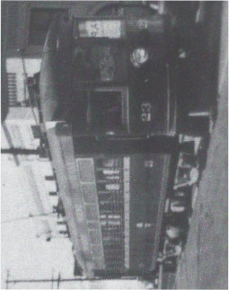
Then Mr. Page and Captain Breeding went to work to build the children’s home and the town. It was not an easy task. The first hard challenge was to carry lumber on a dirt (and often muddy) road from Tulsa to Sand Springs. After many challenging days, Mr. Page and Captain Breeding overcame the difficulties. A water bottling plant and a dairy (where cows were milked and milk was bottled and sold) were completed. Then other businessmen came and built a cotton mill (where cloth was made) and a glass container company (where jars and bottles were made.)
Eventually, a train and streetcars ran from Tulsa to Sand Springs along the road that had first been nothing by a muddy trail.
A Sand Springs Streetcar
Notes:
Source: Clark, Opal Bennefield. A Fool’s Enterprise: The Life of Charles Page, Dexter Publishing Company, 1989. Pg. 70.
Photo Credit: Landis, Jamye K. Images of America: Sand Springs, Oklahoma. Arcadia Publishing, South Carolina. Copyright, 1999.
More about the businesses Mr. Page started: . https://oklahomahof.com/member-archives/p/page-lucile-1958 He also piped natural gas for customers in Tulsa and Sand Springs.

Slide 25
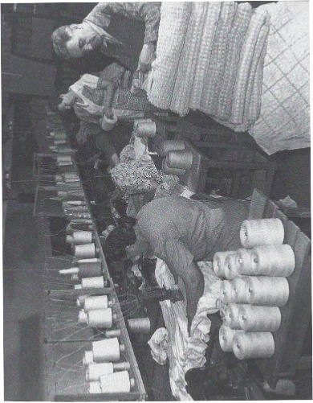
People began to notice the town that Mr. Page was building. Many more people moved into the area to work and start businesses of their own.
Grocery stores, hotels, pharmacies, flower shops, and many other businesses (and jobs) came to the town. Mr. Page sold them land cheaply so that many people who couldn’t have otherwise bought land could pay for it. Sand Springs was growing and becoming a town.
The money that Mr. Page made from all his businesses paid for the children to have food and shelter and for people to take care of them. Charles Page’s dream of building a town had come true.
Many business came to Sand Springs. The Chenille Manufacturing Company was a factory for making cloth.
Notes:
Photo Credit: Landis, Jamye K. Images of America: Sand Springs, Oklahoma. Arcadia Publishing, South Carolina. Copyright, 1999.

Slide 26
Day 2 - Discussion Questions
Who was Mr. Page’s friend and helper?
What did Charles Page and Mr. Breeding decide to do for the children?
How do you think the children felt when they learned they were going to live on a farm?
What kinds of things did people need to live in Sand Springs?
What businesses did Mr. Page build or help others get land so they could build?
Suggested Activities: See Day 2 in the SSMU Standards-based Activities for PreK/K.
Or use the grade specific, standards-based Extension Activity Slides provided on the next 5 slides: PreK, K, 1, 2, 3
The Founder of Sand Springs
Notes:
Teacher Notes: (Some possible answers to discussion questions)
Who was Mr. Page’s friend and helper? (Mr. Breeding)
What did Charlie and Mr. Breeding decide to do for the children?
How do you think the children felt when they learned they were going to live on a farm?
What kinds of things did people need to live in Sand Springs? (roads, street cars, grocery stores, water to drink, etc.)
What businesses did Mr. Page build or help others get land so they could build? (water bottling plant, a canning plant (where food was stored in glass containers), a dairy (where cows were milked and milk was bottled and sold) and a cotton mill (where cloth was made).

Slide 27
OK Social Studies Standards - Pre-K
Use these DAY TWO Extension Activity Slides or see the separate suggested Activities Guide, Resources, and Picture File.
Essential Question: What Do People Need?
Provide students with a blank sheet of paper. Pre-fold the paper to create 4 sections (or invite preschoolers to do it with you as demonstrated). Discuss basic needs that all people have: food, clothing, shelter (homes) and money. Invite students to label the sections and/or draw food in one section, clothing in another section, a home in another section, and money. Stickers, stamps, or pre-cut pictures from magazines could also be used. PK.4.1
Essential Question: How Do People Get What they Need?
Discuss how Sand Springs businesses provided people with money so they could buy what they needed. What kind of jobs do people in our community do today to provide for their needs? Play “job cube” game in teacher notes. PK.4.2
PK.4.1 Identify basic needs all people share.
PK.4.2 Explain that people work to earn money to buy things they need and want.
Notes:
Use cube block (s) or purchase a gamecube to make a “Jobs People Do” Cube. Mod Podge clip art pictures of various occupations or take phone photos of local people (with their permission) and Mod Podge the photos to the cube. Examples: fast food worker, teacher, grocery store clerk, bank teller, police, fire, nurse, doctor etc. Students can roll the cube and say if the job they roll is one they might want to do to make money to provide for their families when they grow up. Discuss how making money is necessary in order to have food, clothing, shelter, and money to buy things that are needed or wanted (like toys.) Discuss how people do these jobs to help our community as well as to make money for their families. NOTE: You will need to sign into TPT in order to see the product link.
Extension: Add occupation books to the book center and continue discussing at appropriate opportunities.

Slide 28
OK Social Studies Standards - K
Essential Question: What Do People Need?
Provide students with a blank sheet of 11x17 paper. Pre-fold the paper to create 4 sections (or invite preschoolers to do it with you as demonstrated). Discuss basic needs that all people have: food, clothing, shelter (homes) and money. Invite students to label the sections and/or draw food in one section, clothing in another section, a home in another section, and money. Stickers, stamps, or pre-cut pictures from magazines could also be used. PK.4.1 Identify basic needs all people share.
Essential Question: How Do People Get What they Need?
Discuss how Sand Springs businesses provided what people with jobs so they could buy what they needed. What kind of jobs do people in our community do today to provide for their needs? Play job cube game in teacher notes. PK.4.2 Explain that people work to earn money to buy things they need and want.
Essential Question: What is the difference between a need and a want? See Activity Guide Day 2 Writing Center for lesson. K.4.2
K.4.1 Describe the basic needs of all people: food, clothing, and shelter; differentiate between these needs and a want.
K.4.2 Explain the relationship between work and earning money.
Notes:
Teacher Notes See Slide 24 for instructions.
A need is something that people need to live: food, water, a place to live, clothing, etc. A want is something that people would like to have that they think would be a good experience to own (toys) or to do (a day at the zoo).

Slide 29
OK Social Studies Standards - 1st
See this document for activities: Primary Sources
1.3 The student will examine important events and historical figures in the nation’s past.
1.3.3 Read and construct basic timelines to understand the chronology of events in history.
1.3.4 Identify primary sources and how they help us to learn about the past.

Slide 30
OK Social Studies Standards - 2nd
See this document for activities: Primary Sources
2.3.3 Compare different accounts of the same historical event using primary and secondary sources.

Slide 31
OK Social Studies Standards - 3rd
See the Virtual Trunk Show Link: Early Sand Springs Industry
Discuss the kinds of businesses that helped to bring economic prosperity to Sand Springs in the early part of the 20th century.
3.4 The student will identify and describe basic economic activities creating prosperity in the state of Oklahoma.

Slide 32
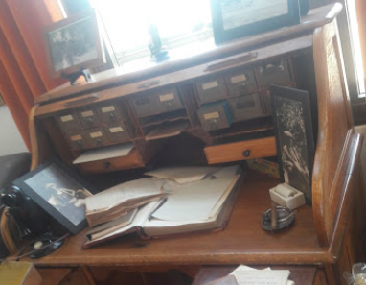
Day 3 - The Children’s Home
Mr. Page had an office in the town now called Sand Springs. He worked at an oak desk. People came to see him all the time. Some needed help. Others just wanted to talk to the man who had built a town so he could take of children.
But Charles Page didn’t just build a children’s home. He remembered the promise he had made to his mother when his father died. He took care of her all her life. He also helped take care of other mothers who needed help, too. In addition to the children’s home, he built small rent free homes for women with children. He also made sure they received milk and other items to make sure they could feed their children. Sometimes, he helped them find jobs as well.
Mr. Page’s oak desk on display at the Sand Springs Cultural and Historical Museum
Notes:
Source: Clark, Opal Bennefield. A Fool’s Enterprise: The Life of Charles Page, Dexter Publishing Company, 1989. Pg. 207 -208; 217.
Teacher Note: Students can see Mr. Page’s desk at the Sand Springs Cultural and Historical Museum.
Photo credit: Sherry Morris, photo taken at the Sand Springs Cultural and Historical Museum in the permanent exhibit gallery.

Slide 33
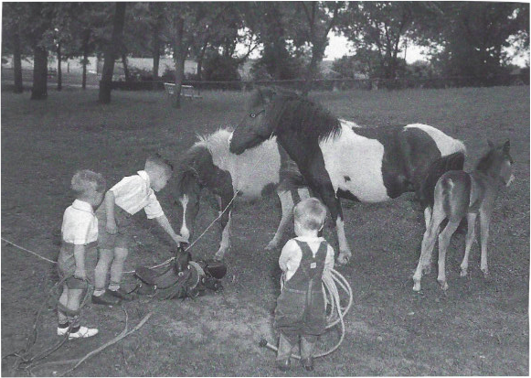
A big house was built on the hill in Sand Springs. It was a home to more than 50 children. The Sand Springs Children’s Home did more than just feed kids and give them a place to live. It also helped them have fun!
Every Sunday night, Mr. and Mrs. Page went to the children’s home to see “his kids.” They often invited guests to come with them to see the place where many children were happily living. There was a playroom, a school room, and a library. The kids could work at jobs around the home to make money of their own.
Christmas was a very special time at the Children’s Home. Every child was asked what they wanted for Christmas and received at least one gift that they wanted. There was always a big Christmas party. “Daddy Page” was there along with his wife, Lucile and their daughter, Mary. Santa always came to visit and everyone had a great time!
Mr. Page provided many extra fun activities for kids living at the Children’s Home.
Notes:
Source: Clark, Opal Bennefield. A Fool’s Enterprise: The Life of Charles Page, Dexter Publishing Company, 1989. Pg. 188; 237
Source and Photo Credit: Landis, Jamye K. Images of America: Sand Springs, Oklahoma. Arcadia Publishing, South Carolina. Copyright, 1999. Pg 32; pg. 24, 33.

Slide 34
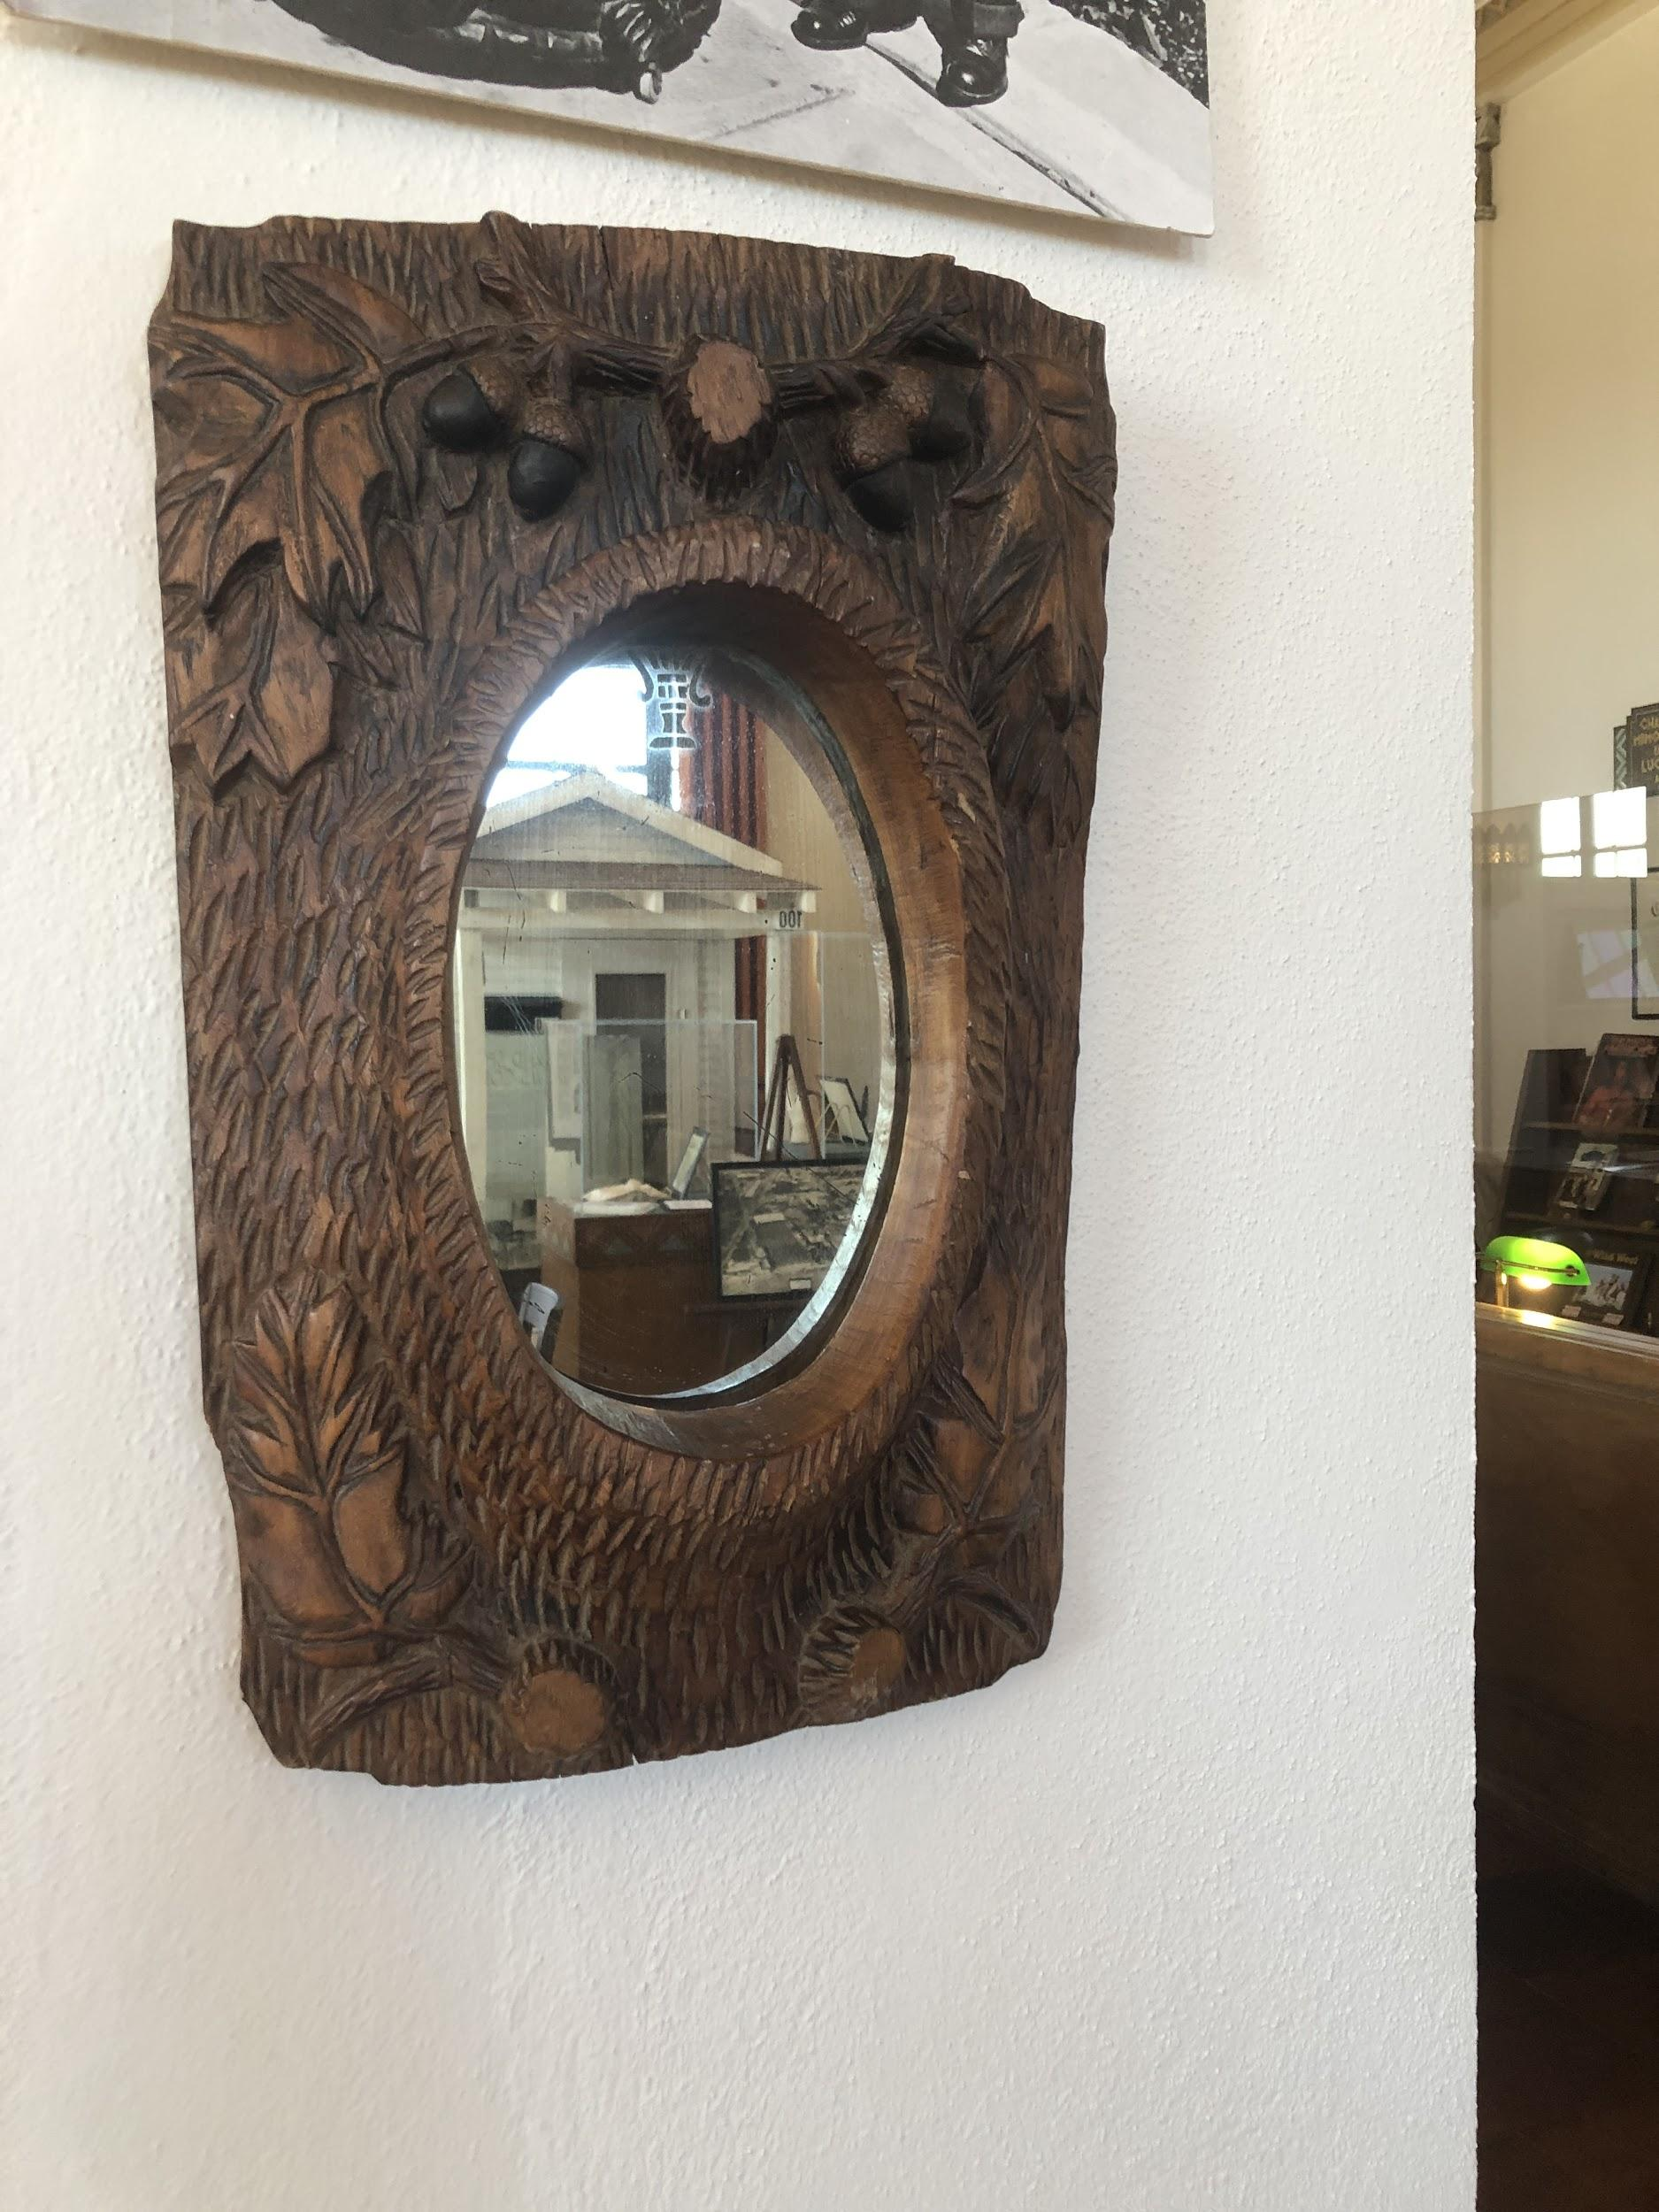
Food for the party in those days might be a little different than the food that we have on our tables today. Instead of turkey or ham, the children might have had bear meat with chestnut dressing, opossum with yams, buffalo hash, duck, or elk with brown gravy.^{2 See Speaker Notes}
Kids at the home had lots of opportunities to play sports, go on trips, and do things for fun. Mr. Page even built an amusement park and a zoo for “his kids” and all of the people in Sand Springs to enjoy!
Boys were taught how to carve from a master woodcarver: Nathan Edward Galloway.³ His woodcarving was known worldwide. There is a piece of his work on display at the Sand Springs Cultural and Historical Museum. His totem pole carving is on display at Totem Pole Park in Foyil, Oklahoma. He also made fiddles and sold them.
A Galloway wood-carved framed mirror
Notes:
2 Landis, Jamye K. Images of America: Sand Springs, Oklahoma. Arcadia Publishing, South Carolina. Copyright, 1999. pg.24.
3 Ibid. pg. Pg. 20-21
Source: Clark, Opal Bennefield. A Fool’s Enterprise: The Life of Charles Page, Dexter Publishing Company, 1989. Pg. 180; 210-213

Slide 35
Today the children’s home is still supported by a group known as the Sand Springs Home Trust. They manage the money from Mr. Page’s businesses and use it still to take care of mothers and children, just like Mr. Page did long ago.
Charles Page’s dream made a special place in Oklahoma with a story that reminds us to “Think Right.” To Mr. Page, an important way to “think right” was to do things to help people and do good things in his community. Do you think that Mr. Page was right?
THINK
RIGHT
Notes:
Teacher Note: The Home receives no state or federal money. It is still a privately fundly venture managed by the Sand Springs Home Trust.

Slide 36
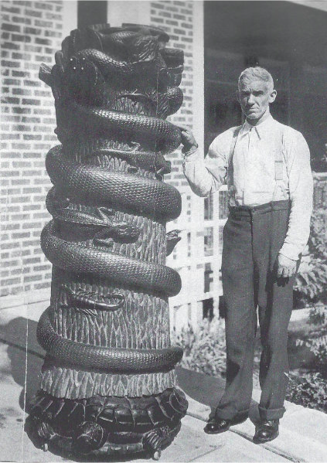
Day 3 - Discussion Questions
What kinds of things did the children at The Children’s Home get to do?
Who was Nathan Edward Galloway?
What did Mr. Galloway do at the children’s home?
·
If you were building a town, what kinds of things would you want to have in your town that people would need?
What do you think about Mr. Page’s idea of building a town that helped others?
Suggested Activities: See Day 2 in the SSMU Standards-based Activities for PreK/K or 1, 2, or 3rd grade lessons.
https://www.nps.gov/nr/travel/route66/galloways_totem_pole_park_foyil.html
Nathan Edward Galloway
Notes:
Teacher Note: (Some possible answers)
What kinds of things did the children at the children’s home get to do? (ride ponies, play sports, have parties, school, church, band, and more)
Who was Ed Galloway? (A master woodcarver)
What did he do at the children’s home? (He taught children to carve wood and make things. Some of the tables and chairs at the museum are the handiwork of Ed Galloway and his students)
·
If you were building a town, what kinds of things would you want to have in your town that people would need?
What do you think about Mr. Page’s idea of building a town that helped others? (Encourage discussion)

Slide 37
3-2-1 - Grades Pre/K - 3
www.oercommons.org/courseware/lesson/55505/student/297120
Introduce the 3-2-1 method of considering what is read or heard.
Think of three facts derived from the reading or telling.
Ask two questions about what was learned.
Give one important statement or fun fact to remember about what was learned.
Older students can write facts, questions, and fun fact here: https://drive.google.com/file/d/1qmU4MaqUl9uTEwA28wVXN5JGy32sThc_/view?usp=sharing

Slide 38
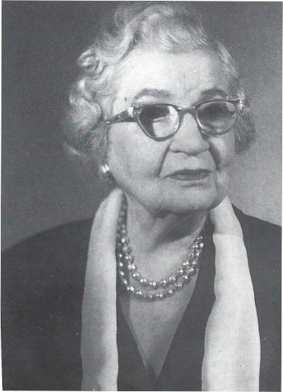
Goodbye, Daddy Page - Day 4
December 27, 1926 was a sad day for the town of Sand Springs. Mr. Page, who started the town had died from pneumonia. Everyone would miss this amazing man who did so much to help others.
Mrs. Page and their daughter, Mary were very sad, too. But they wanted to do something to help people remember Charles Page. Mrs. Page decided to build a library and have a statue created in his honor.
Because of the library she donated and other work she did to help others, Mrs. Page is well-remembered in Sand Springs, too.
Mrs. Lucile Page
Notes:
Teacher Note: Mrs. Page was inducted into the Oklahoma Hall of Fame in 1958 for her donation of the library to Sand Springs. She was at the time the only individual in Oklahoma who gave a library to a town. https://oklahomahof.com/member-archives/p/page-lucile-1958

Slide 39
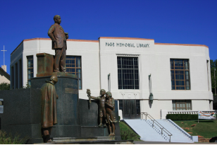
In 1929, the new library opened in Sand Springs. It was made in the art deco style. The library gave children a place to go to check out books for many years.
Today the Charles Page Memorial Library that was built to honor Mr. Page isn’t a library. It is now the Sand Springs Cultural and Historical Museum. The museum is a place to visit and learn about the history of our town. It is also a place to see special exhibits.
The museum has many artifacts that help us learn the story of Sand Springs and more about the life of Charles Page.
The Sand Springs Cultural and Historical Museum
Notes:
Teacher Note: See Resource 4a-e for a Lotto Game and/or Matching game that features photos from this story and Sand Springs Museum artifacts.

Slide 40
Across from the museum in the town triangle is a bronze statue of Mr. Page. Two children and a mother holding a baby are standing on either side of Mr. Page. Mary Page unveiled this statue in 1930. Today the people of Sand Springs go to the town triangle for activities, parades, festivals, and more. The statue of Charles Page stands over the crowd as a reminder of our town’s founder. Sand Springs wouldn’t be a town or have its own unique story without Mr. Page who worked so hard to make his dream of building a town come true.
Built in the 1960’s, Charles Page High School was named after Mr. Page, our town founder.
On the left is a statue of a woman holding a baby. On the right are two children.
Notes:
Photo Credit: Landis, Jamye K. Images of America: Sand Springs, Oklahoma. Arcadia Publishing, South Carolina. Copyright, 1999.

Slide 41
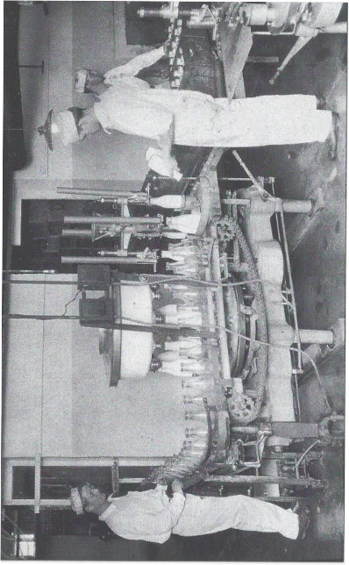
Mr. Page is remembered in Sand Springs and in Oklahoma history because he did something very unique. He created a town that we know today as Sand Springs. He thought that starting businesses would bring money to the community that would allow people to live and work.
Mr. Page also believed that sharing and helping those who needed help was important. From the money he made on his businesses, he helped many mothers and children while he was alive. Even today, Charles Page’s businesses are still making money and the money is still being used to help mothers and children.
The Sand Springs Home Creamery and Dairy provided jobs for people who lived in Sand Springs.
Notes:
Photo Credit: Landis, Jamye K. Images of America: Sand Springs, Oklahoma. Arcadia Publishing, South Carolina. Copyright, 1999.
Teacher Note: Museum docent and hometown storyteller, Connie Fisher, worked at the dairy. He has anecdotes to share with your students. Other hometown storytellers are available to share stories as well about Charles Page and the early days of Sand Springs.

Slide 42
Charles Page’s dream made a special place in Oklahoma with a story that reminds us to “Think Right.” To Mr. Page, to “think right” was to live right in ways that helped his neighbors and community. Just like Mr. Page helped people in Sand Springs, we can help people in our community, too.
The Sand Springs Cultural and Historical Museum has many artifacts that tell the story of Charles Page and our town, Sand Springs, Oklahoma. Artifacts are objects, documents, and other items that show and tell something about the people who lived and worked in Sand Springs.
Essential Question: How can you be a part of the Sand Springs story today?
Charles Page
Founder of Sand Springs
Notes:
Some possible answers: Tell the story of our town; help people when we see the opportunity to do so, take part in community service and activities; start a business; and more.

Slide 43
_{Day 4 - Discussion Questions}
After Mr. Page died, what did Mrs. Page and her daughter decide to do?
Who is the man in statue on the triangle in Sand Springs?
Why do you think there are two children and a mother with a baby standing near him?
How did Charles Page help mothers and children?
What is an artifact?
What can we do to help people in our community like Charles Page did?
Suggested Activities: See Day 4 in the SSMU Standards-based Activities for PreK/K or 1, 2, or 3rd grade lessons.
The Founder of Sand Springs
Notes:
Teacher Notes: (Some possible answers to discussion questions)
After Mr. Page died, what did Mrs. Page and her daughter decide to do? (Built a library and a placed a statue on the triangle in downtown Sand Springs)
Who is the man in statue on the triangle in Sand Springs?
(Charles Page)
Why do you think there are there two children and mother standing near him? (Because he helped mothers and children)
How did Charles Page help mothers and children? (providing for their basic needs)
What can we do to help people in our community like Charles Page did? (Support charities with some of our money – Sand Springs Neighborhood Association is one example. Some people help through their churches or the Salvation Army. There are many ways to give and help.)

Slide 44
OK Social Studies Standards - Pre-K
Use these DAY FOUR Extension Activity Slides or see the separate suggested Activities Guide, Resources, and Picture File.
Invite student to tell about something that happened in the past, today, and that might happen tomorrow.
Then discuss the story using these sentence stems:
● In the past, _____. Example: In the past, Mrs. Page built a library in honor of Mr. Page.
● Long ago, _____. Example: Long ago, Mrs. Page commissioned (paid a sculptor to create) a statue to honor her husband.
● Previously, _____. Example: Previously, Mr. Page did many things to help people in Sand Springs.
● Today, ____. Example: Today, we can help others in our community by _________.
In the future, we can tell others the story of Charles Page.
PK.3 The student will understand that history relates to events and people of other times and places.
PK.3.1 Explain history as things that happened in the past.
PK.3.2 Describe how we honor people and events of the past.
PK.3.3 Use words and phrases, such as before and after, as they relate to chronology and time in order to explain how things change.
PK.3.4 Explain that lessons can be learned from the past.

Slide 45
OK Social Studies Standards - K
Invite student to tell about something that happened in the past, today, and that might happen tomorrow.
Then discuss the story using these sentence stems: K.3.3
● In the past, _____. Example: In the past, Mrs. Page built a library in honor of Mr. Page.
● Long ago, _____. Example: Long ago, Mrs. Page commissioned (paid a sculptor to create) a statue to honor her husband.
● Previously, _____. Example: Previously, Mr. Page did many things to help people in Sand Springs.
● Today, ____. Example: Today, we can help others in our community by _________.
In the future, we can tell others the story of Charles Page.
K.3 The student will understand that history relates to events and people of other times and places.
K.3.1 Explain how events of the past may have affected our community and the way we live today.
K.3.2 Explain how we honor people and events of the past.
K.3.3 Use words and phrases related to chronology and time to explain how things change including before/after and yesterday/today/tomorrow.
Kindergartners can also write and/or draw examples of past, present, and future using a 3 panel piece of folded paper.

Slide 46
OK Social Studies Standards - 1st
Sentence stems for students to use in the story discussion:
● I think the story of Charles Page is important because ___.
● Sand Springs is interesting because ___.
● I didn’t expect that Sand Springs ___.
● Charles Page’s statue reminds us that ____.
1.3.2 Describe the contributions of people and groups who have shaped our history and ways we commemorate important places and events of the past.

Slide 47
OK Social Studies Standards - 2nd
Essential Question
How do we know that the children really called Mr. Page, “Daddy Page”?
Procedure: Introduce primary and secondary sources in historical research.
Explain the difference between primary and secondary sources:
Primary sources provide a first-hand account of an event or time period and are considered to be authoritative.
A secondary source of information is one that was created later by someone who did not experience or have first-hand knowledge of a person’s life or an event.
In writing about historical people and events, writers must use primary and secondary sources because the people or events often happened before they were born.. In the story we just read, the writer told us that the children at the Sand Springs Children’s Home called Mr. Page, “Daddy Page”. How did the writer discover this? How can we verify that the writer was correct. In historical writing, more than one source helps us know if something was or is true.
Source 1
Opal Bennefield Clark Interview - Interview transcript- Voices of Oklahoma - Opal Bennefield Clark, page 10. - This interview is an example of an oral history as a primary source.
http://www.voicesofoklahoma.com/wp-content/uploads/2016/06/Page-Transcript.pdf. pg. 10. (See teacher note below for short transcript)
Source 2
The Sand Springs website has a secondary source written about Charles Page based on other people’s research.
https://sandspringsok.org/483/Historic-Tour-4-Sand-Springs-Home
2.3.3 Compare different accounts of the same historical event using primary and secondary sources.
Discussion:
What is the story that Opal told? What is the story told on the Sand Springs website?
How are they the same?
Different?
Notes:
TEACHER NOTE: EXCERPT FROM OPAL BENNEFIELD CLARK VOICES OF OKLAHOMA TRANSCRIPT: ... I remember Mr. Breeding came with a buggy and took us up to the home. He let us out in the back of the building of the first home that they had built. The children’s home was not very big then. It had been built to house thirty-five people and it had more. And I remember the big stairs, oh, the front, it was beautiful. I just thought that was a castle when I saw it. It was a beautiful place. The white tablecloths and the vases of flowers in the center of the table. And there was a little, bitty, long, low table that just fit me. They had little chairs. Mr. Galloway, who was making the furniture for the home made the wooden lounges and the wooden chairs. And he had made a little, low table for little folks. JE: Nineteen fifteen then, is really when you went to the home. You were three years old. OM: Yes. JE: Charles Page would refer to the orphans as his kids? OM: Yeah, we called him Daddy Page.

Slide 48
OK Social Studies Standards - 3rd
Sentence stems for students to use in the story discussion:
● I think the story of Charles Page is important because ___.
● Sand Springs is interesting because ___.
● I didn’t expect that Sand Springs ___.
● Charles Page’s statue reminds us that ____.
• Oklahoma history has many stories about people. Why do you think Charles Page is still remembered?
Complete the Goodbye, Daddy Page lesson sheet: https://drive.google.com/file/d/1c2_6XoyzSvYLpkzVoJ3Wu0FH1Ls5s4wP/view?usp=sharing
3.3 The student will analyze the significant events and historic personalities contributing to the development of the state of Oklahoma.
3.3.12 Examine notable historic and present-day Oklahomans utilizing biographies and information texts.

Slide 49
Day 5 Review
Grades PreK/K /1- Assessment - Oral Test - See Resource Material 6a or Picture Book Assessment - See Resource link: https://drive.google.com/file/d/1AnzSmEzLeeLgAutA-shHpOZOJG3IyVp-/view?usp=sharing
Grades 2/ 3 - Assessment - Chapter Book - https://drive.google.com/file/d/17X62-rJIWT8zcm6-maq6JVX6VH-hCTyd/view?usp=sharing
Retell the story. Ask students to reflect on this: What is the most important thing to remember about Charles Page?
Answers will vary. Ask students to support their answers.
Choose an assessment:
PreK/K/1 Resource 6 (Oral Test) or Picture Book Writing/Drawing Assignment
Grades 2 & 3 Chapter Book Writing Assignment

Slide 50
Open Education Resources
Links to Hometown Historian Videos: (TBA)
Connie Fisher
Ruth Ellen Henry
Alleene Bishop
Ginger Murphy, Museum Director
Dianna Phillips, Genealogy and Hometown History
https://www.oercommons.org/courseware/lesson/55505/student/297120
https://drive.google.com/file/d/1qmU4MaqUl9uTEwA28wVXN5JGy32sThc_/view?usp=sharing

Slide 51
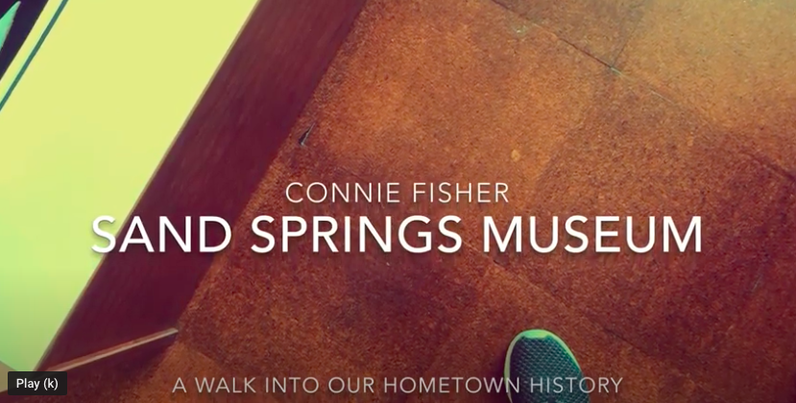
What can be learned at the museum?
More video resources TBA
https://youtu.be/lx9k3PLA6IA
https://youtu.be/ryUBLJuesFM
https://youtu.be/EekIi87EikI
https://youtu.be/kQADPse3Aq0

